Slide 1

Notes:
1. From Prompt to Production
NARRATIVE · WHY THIS MOMENT
Visible lead: Using AI agents to build better course materials
Visible explanation: A teaching need becomes a resource you can inspect, improve, and use.
Suggested narration: 50 seconds
TALK TRACK
Today we will follow a familiar teaching need all the way to a resource students could use. Think of a reading guide, a rubric, a set of slides, or a small interactive lesson. The interesting question is how we get from the idea to something we can open, examine, and improve. Agent tools can take on parts of that production work: drafting, organizing files, building a page, and revising it after feedback. Our contribution is still central. We choose the learning purpose, supply the relevant material, and judge whether the result helps students. Keep one real course in mind as we go. We will return to it throughout the session.
TEACHING POINT
Start with a teaching need and finish with an inspectable resource.
TRANSITION
Begin with a familiar course-preparation moment.
VISUAL DESCRIPTION
A beautiful university faculty workbench with a paper brief, reading, storyboard, rubric, and a completed browser module arranged along a continuous path. Hero composition, generous white space and tactile detail.
SOURCES
- Cursor Quickstart: https://cursor.com/docs/get-started/quickstart
- Google Antigravity Artifacts: https://www.antigravity.google/docs/artifacts/

Slide 2

Notes:
2. A familiar teaching problem
NARRATIVE · WHY THIS MOMENT
Visible lead: One outcome. A reading. A blank page.
Visible explanation: How do we turn what students need to learn into something they can actually use?
Suggested narration: 50 seconds
TALK TRACK
Imagine next week’s class. You have a learning outcome, a reading you trust, and an empty space where the activity needs to go. Perhaps students need to compare two explanations or justify a decision using evidence. You can describe that goal in a sentence, but turning it into clear instructions, a good example, useful feedback, and an accessible resource takes work. That gap between knowing what you want to teach and producing the materials is where we will focus. As you picture your own course, choose something small enough to inspect. A single useful activity gives us more to discuss than an ambitious course redesign that we cannot yet evaluate.
TEACHING POINT
A useful artifact must connect an intended capability to something learners can do.
TRANSITION
Ask what the newer tools change about this work.
VISUAL DESCRIPTION
A faculty desk at the start of preparation: one outcome card, one open reading, one blank teaching page. Thoughtful calm scene with an unfinished artifact, not an overwhelmed stereotype.
SOURCES
Original teaching synthesis; not an empirical outcome claim.

Slide 3

Notes:
3. What has changed?
NARRATIVE · WHY THIS MOMENT
Visible lead: The tools can do more of the production work.
Visible explanation: Current systems can combine language, files, images, code, and tools within a longer workflow.
Suggested narration: 55 seconds
TALK TRACK
What has changed is the range of work a system can coordinate. Some systems can read files, work with images, write code, call tools, and examine the resulting artifact. These capabilities may come from a multimodal model, connected tools, or a combination. We should not assume that every product offers every capability. For our purposes, the practical shift is that a request can lead to a saved reading guide or a working browser activity, followed by revision. The process can extend across several steps. That gives faculty more ways to turn an idea into something tangible, and it gives us something concrete to inspect instead of judging usefulness from an impressive answer alone.
TEACHING POINT
The change is a broader production workflow combining models, context and tools.
TRANSITION
Make the answer-to-artifact shift concrete.
VISUAL DESCRIPTION
An elegant progression from a single response card into an interconnected tangible workspace of files, images, code cards, and a browser artifact. No historical dates, performance claims, or specific software screenshots.
SOURCES
- Gemini Team (2023), Gemini: A Family of Highly Capable Multimodal Models: https://arxiv.org/abs/2312.11805
- Cursor Quickstart: https://cursor.com/docs/get-started/quickstart
- Google Antigravity 2.0 Overview: https://www.antigravity.google/docs/overview
- Google Antigravity Artifacts: https://www.antigravity.google/docs/artifacts/

Slide 4

Notes:
20. Check the account first
NARRATIVE · BUILD WITH A PURPOSE
VISIBLE TEXT
Personal accounts (free or paid) may use your content for model training.
It depends on the service, plan, and settings.
Use an institution-approved account.
Follow your institution’s AI and data policies.
Keep sensitive information out unless explicitly authorized.
Student records • grades • confidential research
For practice: use synthetic or approved non-sensitive material.
TALK TRACK
An account's price does not establish its data protections. Some personal services may use submitted content to improve or train models, subject to their terms and settings. A paid personal subscription alone does not guarantee that this use is excluded. For example, Cursor makes Privacy Mode available on free and Pro accounts; its data-use policy allows training uses when Privacy Mode is off.
Institutional and enterprise plans can have different commitments. Microsoft's enterprise data protection states that covered organizational Copilot prompts, responses, and Microsoft Graph data are not used to train foundation models. OpenAI documents a default exclusion from training for covered Business, Enterprise, and Edu workspace data. Check the actual workspace, enabled feature, and terms with your institution rather than inferring approval from the product name or a university email address.
Training is only one question. Data may still be processed, retained, accessed through a connected service, or shared with another tool under that tool's terms. Running an agent in a local folder does not establish that all processing stays on the device.
Follow your institution's AI, privacy, research, and information-handling policies. Do not submit identifiable student records, grades, confidential research, partner information, or other sensitive material unless your institution explicitly authorizes that particular use, account, and workflow. For these workshop activities, use synthetic examples or materials already approved for this purpose. Ask your institution's IT or privacy team when the policy or account status is unclear.
FACILITATOR CHECK
Confirm the active account and workspace, the allowed data category, and any file or connector access before the demonstration. Do not invite the audience to upload actual student work as a quick test.
TRANSITION
With the account and inputs settled, turn the teaching need into a design brief.
SOURCES
Checked 2026-09-23. These sources illustrate differences among services and account types; they do not replace institutional policy.
- Cursor Security: https://cursor.com/security
- Cursor Data Use: https://cursor.com/data-use
- Microsoft 365 Copilot enterprise data protection: https://learn.microsoft.com/en-us/microsoft-365/copilot/enterprise-data-protection
- OpenAI, ChatGPT Work local security: https://learn.chatgpt.com/docs/enterprise/chatgpt-work-local-security

Slide 5

Notes:
4. From an answer to an artifact
NARRATIVE · WHY THIS MOMENT
Visible lead: The useful shift is in the workflow.
Visible explanation: A system can draft, use tools, inspect results, and revise. A chat window may support that workflow too.
Suggested narration: 55 seconds
TALK TRACK
Suppose we ask for an explanation of climate feedbacks. A written answer might already help us prepare. Now imagine continuing: turn that explanation into a short lesson, add an example, save the page, open it, and fix an unclear section. We now have a sequence of actions around an artifact. The important distinction is the workflow. A chat interface can support tool use and this kind of iteration too. We do not need to divide products into two magical categories. Ask what the system can actually read, change, and inspect. Then ask what evidence would convince you the lesson works. To understand why this can be useful, and where it can go wrong, let us look inside the language part.
TEACHING POINT
An artifact creates opportunities to test and revise beyond evaluating a response.
TRANSITION
Explain the language model that participates in that workflow.
VISUAL DESCRIPTION
Two linked stages in one workspace: a conversation sheet leads into an inspectable lesson webpage with visible revision annotations. No binary opposition or implication that chat can never use tools.
SOURCES
- Yao et al. (2023), ReAct: Synergizing Reasoning and Acting in Language Models: https://arxiv.org/abs/2210.03629
- Anthropic (2024), Building effective agents: https://www.anthropic.com/engineering/building-effective-agents
- Google Antigravity Artifacts: https://www.antigravity.google/docs/artifacts/

Slide 6

Notes:
5. What is a language model?
NARRATIVE · HOW THE TECHNOLOGY WORKS
Visible lead: It learns patterns that help it generate language.
Visible explanation: Training on large amounts of text, including code, shapes how a model responds to new context.
Suggested narration: 55 seconds
TALK TRACK
A language model is a mathematical system trained to work with sequences of language. Large models develop patterns from substantial training material, often including text and code. Those patterns influence how the model responds when we give it a new question, example, or document. They can support many useful behaviours: explaining, comparing, summarizing, and producing code. Calling these patterns simple phrase matching would miss the complexity of the system. At the same time, a fluent answer does not tell us which source supports it. Generating an answer and consulting a particular source are different operations. We will return to that distinction. First, the model needs a way to represent the text we supply.
TEACHING POINT
A language model generates responses using patterns developed through training.
TRANSITION
Introduce tokens as the units the model processes.
VISUAL DESCRIPTION
Layered pieces of text and code converge into a textured abstract pattern network and emerge as a fresh written response. Human-scale academic illustration; no robot brain or literal library lookup.
SOURCES
- Brown et al. (2020), Language Models are Few-Shot Learners: https://arxiv.org/abs/2005.14165
- Vaswani et al. (2017), Attention Is All You Need: https://arxiv.org/abs/1706.03762

Slide 7
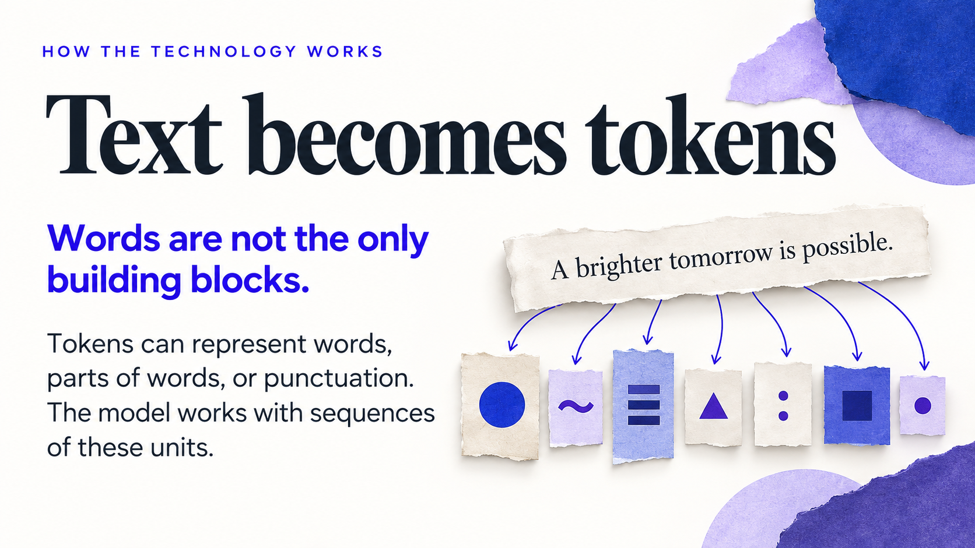
Notes:
6. Text becomes tokens
NARRATIVE · HOW THE TECHNOLOGY WORKS
Visible lead: Words are not the only building blocks.
Visible explanation: Tokens can represent words, parts of words, or punctuation. The model works with sequences of these units.
Suggested narration: 50 seconds
TALK TRACK
The system converts text into units called tokens. A token might correspond to a whole word, a piece of a word, or punctuation. The exact division depends on the tokenizer and its vocabulary, so these paper tiles are a conceptual illustration rather than the precise encoding of this sentence. The useful idea is a sequence of reusable units. The model processes numerical representations of those units, not printed words on a page. This helps explain why word counts and token counts differ, and why seemingly small changes in wording can change the input sequence. We do not need to calculate tokens for today’s activities. We do need to understand what training does with them.
TEACHING POINT
Tokens are reusable text units, not necessarily whole words.
TRANSITION
Separate the representation of text from the training process.
VISUAL DESCRIPTION
A sentence strip gently separates into differently sized paper tiles with minimal abstract glyphs, becoming a sequence. No invented tokenizer-specific numeric IDs or exact example segmentation.
SOURCES
- Hugging Face Transformers: Tokenization algorithms: https://huggingface.co/docs/transformers/tokenizer_summary

Slide 8
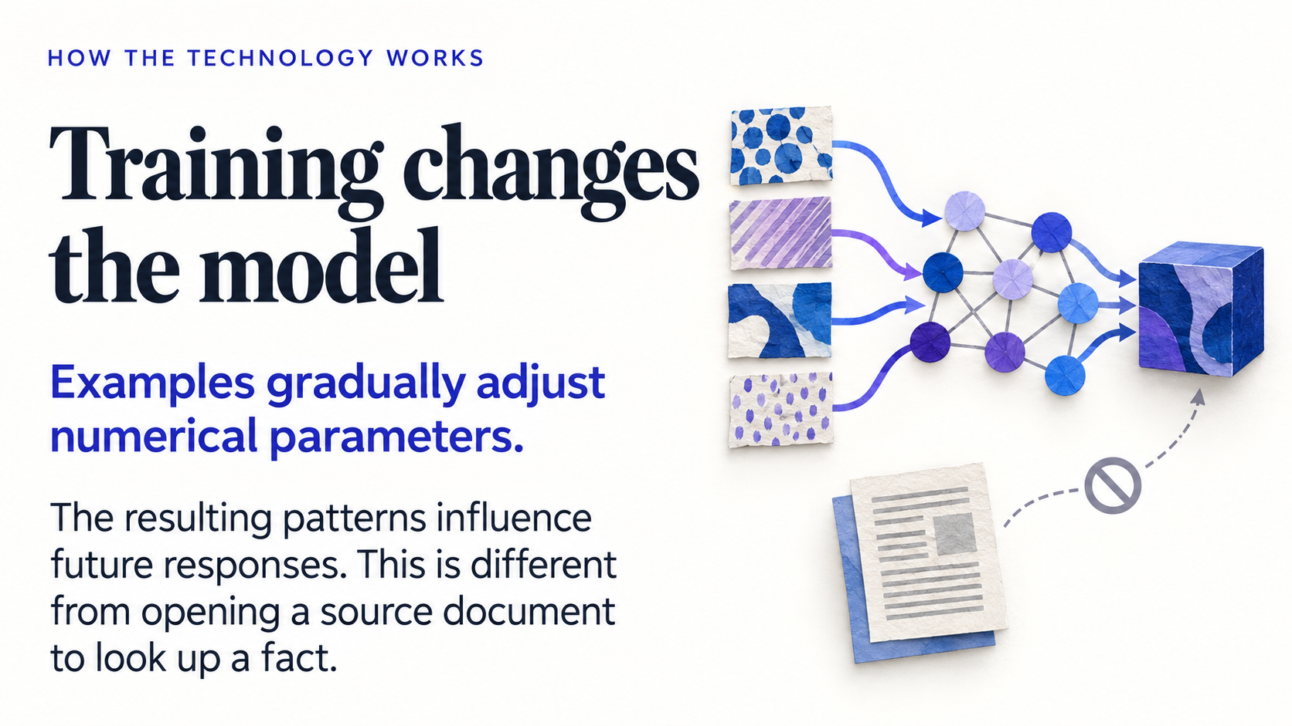
Notes:
7. Training changes the model
NARRATIVE · HOW THE TECHNOLOGY WORKS
Visible lead: Examples gradually adjust numerical parameters.
Visible explanation: The resulting patterns influence future responses. This is different from opening a source document to look up a fact.
Suggested narration: 60 seconds
TALK TRACK
During training, the system repeatedly compares its predictions with training examples and adjusts numerical parameters. Across many updates, those parameters shape how the model responds to later inputs. Think of this as developing a complex set of dispositions for handling language, rather than filing every document into a searchable shelf. Models can memorize some material, so the metaphor has limits. The central point is that a generated answer does not establish that the system just opened a source and checked it. A tool can perform that separate retrieval step. This matters for teaching: a polished explanation may be useful as a draft, while its claims still need evidence. Training shapes the model; the current context shapes this particular response.
TEACHING POINT
Training changes numerical parameters; retrieving a source is a separate process.
TRANSITION
Show how current context affects the use of those learned patterns.
VISUAL DESCRIPTION
A sequence of paper pattern swatches passing through a gently adjusting network of connections, final pattern retained in a compact model. Source document sits separately as a different operation.
SOURCES
- Brown et al. (2020), Language Models are Few-Shot Learners: https://arxiv.org/abs/2005.14165
- Lewis et al. (2020), Retrieval-Augmented Generation for Knowledge-Intensive NLP Tasks: https://arxiv.org/abs/2005.11401

Slide 9
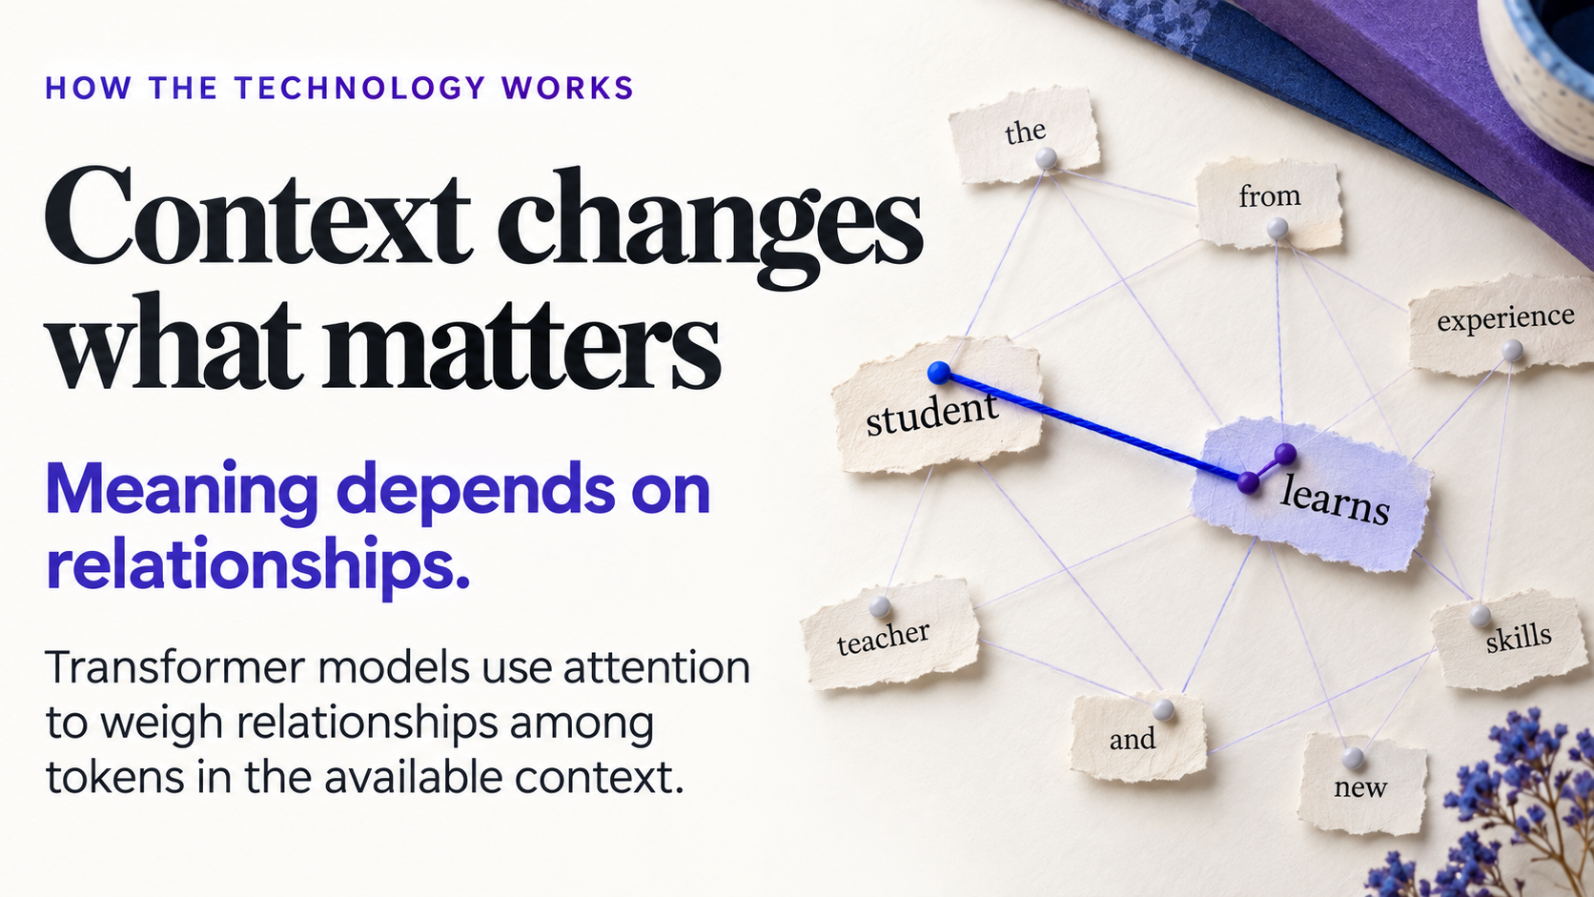
Notes:
8. Context changes what matters
NARRATIVE · HOW THE TECHNOLOGY WORKS
Visible lead: Meaning depends on relationships.
Visible explanation: Transformer models use attention to weigh relationships among tokens in the available context.
Suggested narration: 55 seconds
TALK TRACK
Consider the word bank in a sentence about a river and in a sentence about a loan. Nearby material helps determine which relationships matter. Transformer models use a mechanism called attention to combine information across tokens in the available context. The threads here are a metaphor for those weighted relationships; they are not a diagram of measured weights in a real model. Attention is a mathematical operation, so it does not mean human concentration or prove understanding. Still, it helps explain why the same request can produce different responses when we add an audience, a reading, or an example. The response depends on relationships in the material the system has available at that moment.
TEACHING POINT
Attention builds context-sensitive representations by weighting token relationships.
TRANSITION
Connect contextual representations to the unfolding response.
VISUAL DESCRIPTION
Several paper text fragments on a desk connected with fine colored thread, one relevant relation emphasized and irrelevant threads faint. A precise conceptual attention visualization without equations.
SOURCES
- Vaswani et al. (2017), Attention Is All You Need: https://arxiv.org/abs/1706.03762

Slide 10
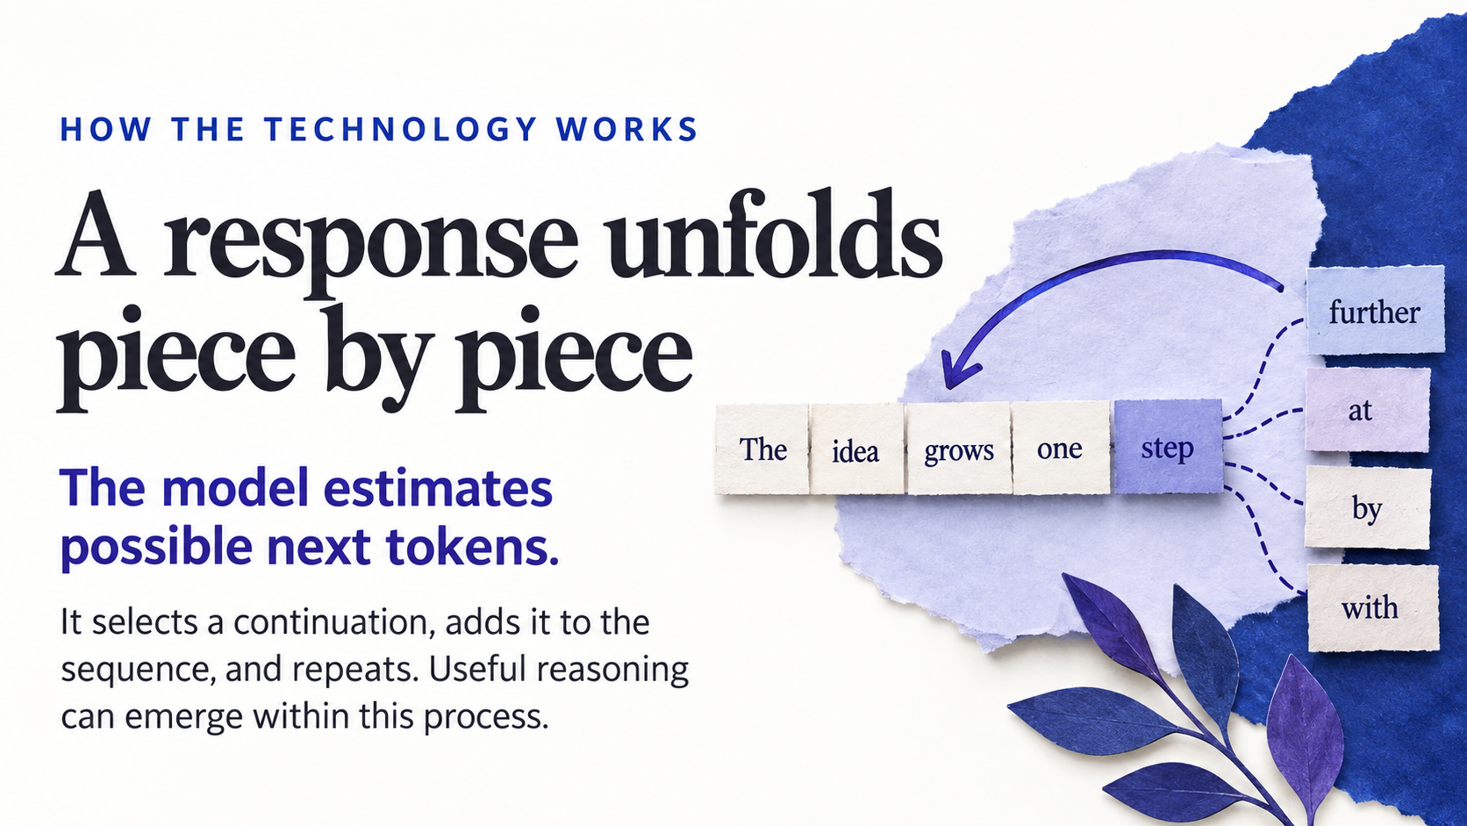
Notes:
9. A response unfolds piece by piece
NARRATIVE · HOW THE TECHNOLOGY WORKS
Visible lead: The model estimates possible next tokens.
Visible explanation: It selects a continuation, adds it to the sequence, and repeats. Useful reasoning can emerge within this process.
Suggested narration: 60 seconds
TALK TRACK
For this kind of language generation, the model estimates possible next tokens, a continuation is selected, and that new material becomes part of the sequence. The process repeats. It does not necessarily choose the single most likely token every time; generation settings and system design affect selection. This is the underlying mechanism, not a complete description of what the system can accomplish. A sequence of generated steps can carry useful reasoning, write a program, or propose a plan. Saying next-token prediction therefore does not settle whether a particular answer reasons well. We should examine the reasoning and test the result. A convincing sequence can still contain an error, which is why our criteria and checks will matter.
TEACHING POINT
Next-token generation is a mechanism compatible with useful reasoning, not a truth check.
TRANSITION
Distinguish broad language training from assistant-oriented training.
VISUAL DESCRIPTION
A paper response strip extending one tile at a time from several possible continuation tiles, one chosen and others left as alternatives. A loop arrow returns to the growing sequence, no made-up probability numbers.
SOURCES
- Brown et al. (2020), Language Models are Few-Shot Learners: https://arxiv.org/abs/2005.14165
- Yao et al. (2023), ReAct: Synergizing Reasoning and Acting in Language Models: https://arxiv.org/abs/2210.03629

Slide 11

Notes:
10. How does it become an assistant?
NARRATIVE · HOW THE TECHNOLOGY WORKS
Visible lead: Different training stages shape different behaviours.
Visible explanation: Broad training develops patterns. Further training can improve instruction following, usefulness, and other desired behaviours.
Suggested narration: 55 seconds
TALK TRACK
A model trained broadly on language is not automatically the helpful assistant we meet in a product. Further training can use demonstrations of good responses, comparisons between responses, and other feedback to shape its behaviour. For example, developers may train it to follow instructions more consistently or produce responses people find useful. Different systems use different combinations of methods; this diagram is a simplified pathway rather than a recipe shared by every product. These stages help explain why an assistant responds to a request instead of merely continuing an arbitrary document. They also help explain an important limit: being trained to be helpful is not the same as having every claim checked against evidence.
TEACHING POINT
Further training can shape assistant behaviour without guaranteeing truth.
TRANSITION
Explain why polished assistant behaviour still requires verification.
VISUAL DESCRIPTION
Three conceptual training stages: broad patterned material, worked instruction-and-response examples, and review feedback, leading to a helpful draft. No guarantee-of-truth seal.
SOURCES
- Ouyang et al. (2022), Training language models to follow instructions with human feedback: https://arxiv.org/abs/2203.02155
- Brown et al. (2020), Language Models are Few-Shot Learners: https://arxiv.org/abs/2005.14165

Slide 12

Notes:
11. Fluent does not mean verified
NARRATIVE · HOW THE TECHNOLOGY WORKS
Visible lead: A convincing sentence can still be wrong.
Visible explanation: An answer may invent a citation, miss a condition, or produce instructions that fail when someone tries them.
Suggested narration: 60 seconds
TALK TRACK
The writing can sound ready to publish before the content is ready to teach. A model might produce an incorrect detail, a reference that does not exist, or instructions that fail when someone follows them. These errors are often called hallucinations; that label describes the output rather than an intention to deceive. The paper and broken-link symbol here represent the checking problem, not a real study. For faculty, the useful response is specific: open a cited source, check that it supports the statement, and try the proposed procedure. Asking the same system whether it is sure can prompt revision, but its reassurance is not independent evidence. Good context helps, and we will supply it deliberately.
TEACHING POINT
Fluency and citations do not independently verify a claim.
TRANSITION
Show how relevant context can improve the task definition.
VISUAL DESCRIPTION
A beautifully typeset academic paragraph on paper examined under a magnifying glass that reveals one unsupported reference and a broken link represented symbolically. Calm evidence-review scene.
SOURCES
- Kalai et al. (2025), Why Language Models Hallucinate: https://arxiv.org/abs/2509.04664
- Gao et al. (2023), Enabling Large Language Models to Generate Text with Citations: https://aclanthology.org/2023.emnlp-main.398/

Slide 13

Notes:
12. Context is the working material
NARRATIVE · HOW THE TECHNOLOGY WORKS
Visible lead: Your brief changes the task the model sees.
Visible explanation: Readings, examples, requirements, and the conversation help shape the next response. Relevant context matters more than a large pile of files.
Suggested narration: 60 seconds
TALK TRACK
Think of context as the working material for this request. Our course brief can identify the learners, the outcome, the intended artifact, and the constraints. A selected reading can supply the content boundary. A worked example can show the level of explanation we want. Together, these make the task more specific than ‘make a lesson about sustainability.’ Adding more files is not automatically better: material must be relevant, available to the system, and actually used. Research has shown that the ability to accept a long input and the ability to use its contents well are different questions. We will make our essential requirements easy to locate and then inspect whether the resulting artifact follows them.
TEACHING POINT
Select relevant context and define the task instead of relying on volume.
TRANSITION
Distinguish supplying context from retraining or permanent memory.
VISUAL DESCRIPTION
A carefully selected brief, reading, worked example, and requirement cards placed on one active workbench while irrelevant papers remain outside the workspace. Clear purposeful selection.
SOURCES
- Brown et al. (2020), Language Models are Few-Shot Learners: https://arxiv.org/abs/2005.14165
- Liu et al. (2024), Lost in the Middle: How Language Models Use Long Contexts: https://aclanthology.org/2024.tacl-1.9/
- Cursor Quickstart: https://cursor.com/docs/get-started/quickstart

Slide 14

Notes:
13. A file is context, not a new degree
NARRATIVE · HOW THE TECHNOLOGY WORKS
Visible lead: Supplying a reading usually does not retrain the model.
Visible explanation: Saved files and project memory can carry information forward, but availability and use depend on the system.
Suggested narration: 55 seconds
TALK TRACK
When we provide a reading, the system can use it as context without updating the model’s trained parameters. In-context examples can change the response while the underlying model stays the same. A product may also save files, conversation history, or project memory and bring some of that information into a later task. That is persistence outside the model, and its availability depends on the product and settings. We should therefore avoid assuming that an upload has permanently taught the model our course, or that a file saved somewhere will automatically be considered next time. Make the important material explicit in the project and check its use. Now we can add tools and see how a workflow becomes more active.
TEACHING POINT
In-context use, external persistence and parameter training are different mechanisms.
TRANSITION
Move from generating responses to acting through tools.
VISUAL DESCRIPTION
A temporary working desk containing an open reading connected to a stable model object, with an external filing cabinet showing saved context. No literal brain acquiring a diploma, tasteful metaphor.
SOURCES
- Brown et al. (2020), Language Models are Few-Shot Learners: https://arxiv.org/abs/2005.14165
- Lewis et al. (2020), Retrieval-Augmented Generation for Knowledge-Intensive NLP Tasks: https://arxiv.org/abs/2005.11401
- Google Antigravity 2.0 Overview: https://www.antigravity.google/docs/overview

Slide 15

Notes:
14. An agent adds an action loop
NARRATIVE · HOW THE TECHNOLOGY WORKS
Visible lead: Plan. Use a tool. Inspect. Revise.
Visible explanation: The model helps choose steps; software executes tools. The loop can produce files and other artifacts that need human review.
Suggested narration: 60 seconds
TALK TRACK
An agent workflow adds an action loop around the model. The system can propose a step, ask software to execute a tool, receive an observation, and decide what to do next. For a course module, that might mean writing a file, opening it in a browser, spotting a broken button, and revising the code. The model is helping choose actions; the surrounding software performs them. We have not introduced a separate kind of intelligence just by calling this an agent. We have connected capabilities into a workflow that can affect files and produce artifacts. Those artifacts still need review, and the task needs boundaries and a stopping point. Our most important boundary comes first: what should students learn?
TEACHING POINT
An agent combines model-directed steps, executable tools and feedback in a bounded workflow.
TRANSITION
Move to slide 15, Start with the learning.
VISUAL DESCRIPTION
A clear four-part circular paper workflow around a tangible course module: plan icon, tool icon, inspection lens, revision pencil. Faculty hand checks the resulting artifact. Keep diagram free of additional small text.
SOURCES
- Yao et al. (2023), ReAct: Synergizing Reasoning and Acting in Language Models: https://arxiv.org/abs/2210.03629
- Anthropic (2024), Building effective agents: https://www.anthropic.com/engineering/building-effective-agents
- Cursor Quickstart: https://cursor.com/docs/get-started/quickstart
- Google Antigravity Artifacts: https://www.antigravity.google/docs/artifacts/

Slide 16

Notes:
15. Start with the learning
NARRATIVE · BUILD WITH A PURPOSE
Visible lead: The first question is what students should be able to do.
Visible explanation: A polished resource becomes useful when it helps learners produce evidence of that capability.
Suggested narration: 55 seconds
TALK TRACK
We now know enough about the technology to ask a teaching question. In the campus example, the goal is not simply to produce a page about transport. Students should compare two proposals and justify a recommendation using two relevant pieces of evidence, a tradeoff, and a limitation. That description tells us what a useful resource must help them practise. It also tells us what to inspect in the output. A beautiful page that invites only a preference has missed the goal. Start with a piece of student work you would recognize as evidence of learning, then ask what would help a student produce it.
TEACHING POINT
Define the student capability and observable evidence before choosing the generated artifact.
TRANSITION
Use the next activity, Define the win, to name one learner performance and the evidence that would reveal it.
VISUAL DESCRIPTION
A student reasoning artifact and a learning target placed in the foreground, a shiny generic resource receding behind them. Visual emphasis on meaningful student work.
SOURCES
- Krathwohl (2002), A Revision of Bloom's Taxonomy: An Overview: https://ou.edu/content/dam/assessment/docs/Theory%20Into%20Practice.pdf

Slide 17

Notes:
16. Define the win
EMBEDDED ACTIVITY · START WITH A NEED
Original activity-library number: 2
TRY THIS: Describe the learners, the learning outcome, and the evidence you want to see.
MAKE: A three-line design brief
CHECK: Could another instructor use it?
PLACE IN THE STORY
Ask for a teaching need before asking for a product. This is the first short audience participation moment after the explanation of the technology.
FULL ACTIVITY TIME
About 3 minutes if completed as a standalone exercise. In the presentation, this may be a short demonstration, audience decision, or take-home invitation.
TOOL
Any chat or agent environment
INPUTS
A teaching need and the COURSE_BRIEF.md example.
COPYABLE PROMPT
Turn this need into a three-line brief: learners and prior knowledge; one observable learning outcome; evidence students will produce. Example: first-year sustainability students compare two campus transport proposals and justify a recommendation using supplied data and one stated limitation. Flag missing context without inventing course policy. Save drafts/design-brief.md. Offer one stronger and one weaker example of evidence so I can compare.
STEPS
1. Describe learners and prior knowledge.
2. Replace 'understand' with an observable performance.
3. Decide what student work will reveal that performance.
EXPECTED OUTPUT
A three-line design brief
REVIEW CHECKS
- The outcome describes student work.
- The evidence fits the outcome.
- No policy or course fact was invented.
FACILITATOR NOTES
Model the distinction between making a resource attractive and making its learning purpose inspectable. A good output can be a 150-word recommendation, an annotated comparison, or an explanation, depending on the actual goal.
VISUAL DESCRIPTION
Three large interlocking paper cards illustrated with adult learners, a target, and a student-created artifact. Elegant editorial illustration.
SOURCES
Original teaching synthesis; not an empirical outcome claim.

Slide 18

Notes:
17. What can an agent help make?
NARRATIVE · BUILD WITH A PURPOSE
Visible lead: Think in artifacts you can open and inspect.
Visible explanation: Reading guides, cases, rubrics, slide decks, question banks, and small interactive resources can share the same brief.
Suggested narration: 55 seconds
TALK TRACK
Once the learning purpose is clear, the same brief can support several useful objects. Our campus case might become a reading guide that directs attention to the evidence, a rubric that distinguishes a supported recommendation from an assertion, or a small page where students explore the data. These are different ways to support the same learning. We can inspect each one: read the questions, apply the rubric, or operate the page. The opportunity is to develop a family of coherent materials from a shared purpose. The available toolchain determines which formats can actually be produced, and each output still needs its own review.
TEACHING POINT
Think in inspectable teaching artifacts while keeping a shared purpose across them.
TRANSITION
Two current workspaces can support this pattern; their interface details differ, but the teaching process transfers.
VISUAL DESCRIPTION
A fan of six distinct high-quality faculty artifacts: reading guide, case card, rubric table, slides, question cards, interactive module. Tactile and visually differentiated.
SOURCES
- Cursor Quickstart: https://cursor.com/docs/get-started/quickstart
- Google Antigravity Artifacts: https://www.antigravity.google/docs/artifacts/

Slide 19
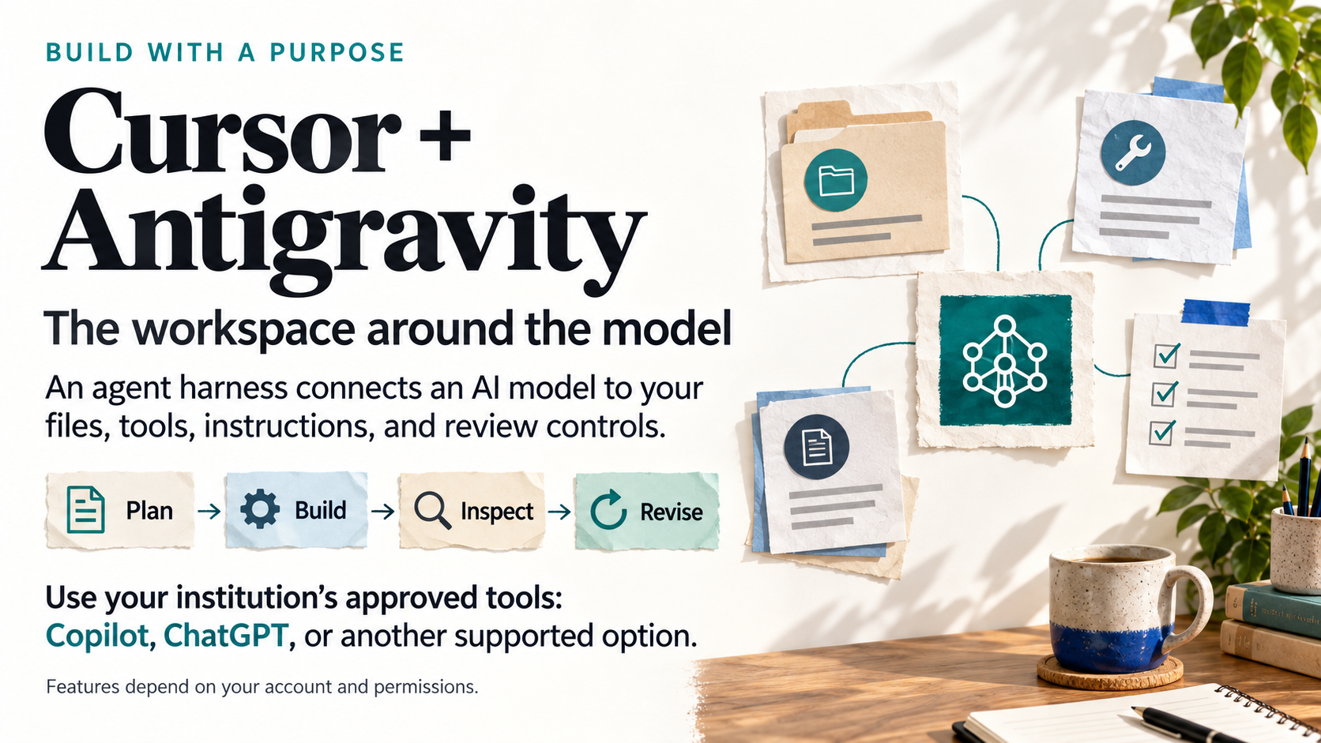
Notes:
19. Cursor + Antigravity: the workspace around the model
EMBEDDED ACTIVITY · START WITH A NEED
Combined preview replacing the two separate Cursor and Antigravity activities.
VISIBLE TEXT
Cursor + Antigravity
The workspace around the model
An agent harness connects an AI model to your files, tools, instructions, and review controls.
Plan → Build → Inspect → Revise
Use your institution’s approved tools: Copilot, ChatGPT, or another supported option.
Features depend on your account and permissions.
TALK TRACK
Cursor and Antigravity are examples of agent workspaces. The harness is the surrounding software: it provides instructions and context, makes tools available, manages permissions, and coordinates the sequence of model responses and tool actions. The model can propose a step; software carries out the available tool action and returns the result. We still inspect the plan and the artifact.
For faculty, the useful pattern is to start with a teaching brief, review a small plan, create a resource, open it, and revise it. A resource might be a rubric, a case, a reading guide, a slide deck, or an interactive page.
Use an account and service approved by your institution. Copilot, ChatGPT, and other supported tools can cover many of these tasks, depending on the plan, enabled features, integrations, and permissions. Do not assume every account can edit local files or run the same tools. A chat interface can still support planning, drafting, and revision.
COMBINED DEMONSTRATION
Show the process once in an approved environment. Use the supplied public or synthetic workshop materials. Ask for a plan, correct one teaching decision, authorize a small build, and inspect the result directly. In a chat-only tool, work on the content and review criteria, then move the approved draft into the appropriate application.
COPYABLE PROMPT
Using only this approved teaching brief and supplied practice materials, plan one small learning resource. State its learning outcome, format, content, and checks. Wait for my review before building. After I approve the plan, create the resource using the tools available in this account. Explain what you actually checked and what I still need to test.
REVIEW QUESTION
Does the resource elicit the learning we intended, and what evidence shows that it works?
TRANSITION
Before giving any workspace access to course materials, check the account and the information you are about to share.
SOURCES
Checked 2026-09-23.
- Cursor documentation: https://cursor.com/docs
- Google Antigravity IDE: https://antigravity.google/product/antigravity-ide
- Google Antigravity agent settings: https://www.antigravity.google/docs/agent-settings

Slide 20
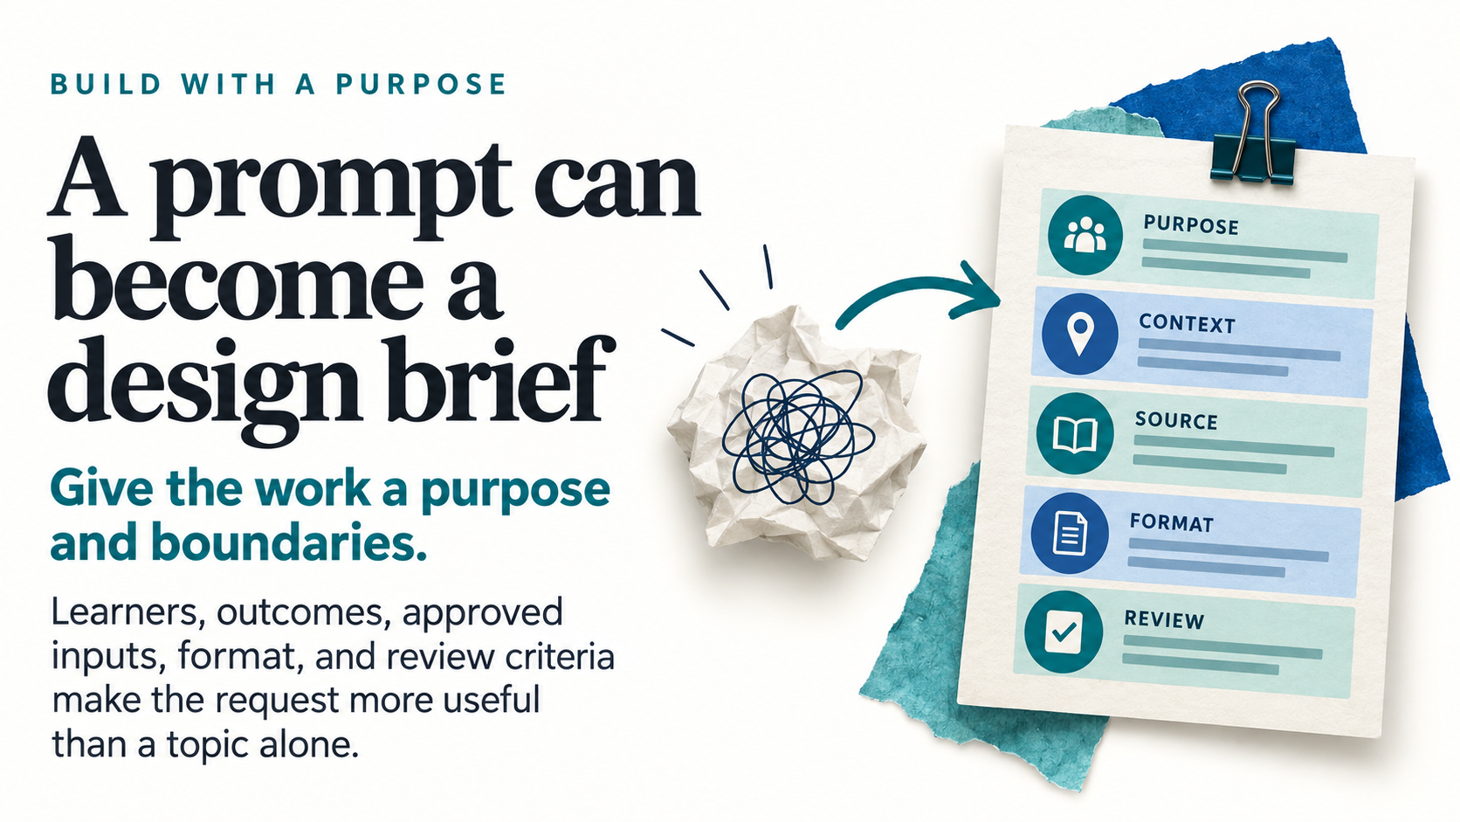
Notes:
21. A prompt can become a design brief
NARRATIVE · BUILD WITH A PURPOSE
Visible lead: Give the work a purpose and boundaries.
Visible explanation: Learners, outcomes, approved inputs, format, and review criteria make the request more useful than a topic alone.
Suggested narration: 55 seconds
TALK TRACK
A topic such as campus sustainability leaves many decisions unstated. The model can fill those spaces with a plausible generic lesson, but it cannot know which choices fit this class. A design brief supplies the working context: who the learners are, what they need to do, which materials are approved, the output we want, and what counts as useful. This changes the current task context; it is not a new round of model training. In our example, naming the synthetic dataset and its limits matters as much as specifying HTML or slides. Saving these decisions gives later drafting and review passes the same starting point.
TEACHING POINT
A saved brief makes teaching requirements explicit and reusable without implying that prompting retrains the model.
TRANSITION
The next activity turns one of your teaching needs into a reusable course brief.
VISUAL DESCRIPTION
An unfocused topic scrap develops into a well-structured project brief with five visually distinct purpose/context/source/format/review areas. Show no extra tiny writing.
SOURCES
- Brown et al. (2020), Language Models are Few-Shot Learners: https://arxiv.org/abs/2005.14165
- Cursor Quickstart: https://cursor.com/docs/get-started/quickstart

Slide 21

Notes:
22. Give the agent a brief
EMBEDDED ACTIVITY · START WITH A NEED
Original activity-library number: 3
TRY THIS: Write the course context, approved sources, constraints, and review criteria in one reusable file.
MAKE: COURSE_BRIEF.md
CHECK: Are the requirements specific?
PLACE IN THE STORY
Now move from the prepared demonstration to the participant's own context. A two-minute rewrite of the brief is enough for the presentation route.
FULL ACTIVITY TIME
About 5 minutes if completed as a standalone exercise. In the presentation, this may be a short demonstration, audience decision, or take-home invitation.
TOOL
Cursor, Antigravity, or a text editor
INPUTS
faculty-starter-kit/COURSE_BRIEF.md and the example inputs.
COPYABLE PROMPT
Read COURSE_BRIEF.md. Propose improvements to this reusable course-development brief. Include learners, prior knowledge, outcomes, teaching context, approved inputs, boundaries, output format, and review criteria. Preserve facts in the supplied files, mark unknowns as questions, and do not silently fill them in. Save a proposed revision as drafts/COURSE_BRIEF-proposed.md, leaving the original intact.
STEPS
1. Open the supplied brief and replace the example context with your course.
2. Add approved readings and explicit constraints.
3. Ask the agent to read the file at the start of each task.
EXPECTED OUTPUT
COURSE_BRIEF.md
REVIEW CHECKS
- Brief states audience, outcome, sources, deliverable, and review criteria.
- Missing facts remain visible.
- Agent can summarize the requirements accurately.
FACILITATOR NOTES
A plain Markdown file does not automatically control every agent. Direct the agent to read it and name the file in the prompt. Keep originals distinct from drafts; instructor approval is a teaching decision, not the agent's completion message. Demo materials contain no real student records.
VISUAL DESCRIPTION
A large open course brief on a clean desk, four colorful tabs represented by icons for context, sources, boundaries, review. Refined paper and ink scene.
SOURCES
- Cursor Quickstart: https://cursor.com/docs/get-started/quickstart

Slide 22

Notes:
23. Give the work a home
NARRATIVE · BUILD WITH A PURPOSE
Visible lead: Files make the process visible and reusable.
Visible explanation: Keep source material, drafts, review findings, and accepted versions easy to find. A folder helps the next revision begin.
Suggested narration: 55 seconds
TALK TRACK
The folder is part of the teaching process. Keep the original campus scenario and data intact, place drafts where they can be compared, and keep the review findings beside the revised work. When the class changes next term, those files explain why a particular choice was made. They also help an agent work from the accepted version instead of an abandoned draft. A saved file does not guarantee that every tool will read or remember it; explicitly direct the agent to the relevant brief and materials. We are making the work visible enough for a colleague, a future session, or our future selves to continue it.
TEACHING POINT
Organized files preserve context and decisions; they are not a guarantee of automatic agent memory.
TRANSITION
With shared context available, we can divide a complicated task into distinct responsibilities.
VISUAL DESCRIPTION
A beautiful organized academic project workspace with original readings, draft versions, review notes, and final resource separated into four tangible folders. No machine-specific path text.
SOURCES
- Cursor Quickstart: https://cursor.com/docs/get-started/quickstart

Slide 23

Notes:
24. Roles divide the work
NARRATIVE · BUILD WITH A PURPOSE
Visible lead: A researcher, writer, and critic notice different things.
Visible explanation: Each needs the same purpose, a bounded task, and a distinct output. The educator connects the results.
Suggested narration: 55 seconds
TALK TRACK
A researcher, a writer, and a critic are responsibilities we assign. For the campus activity, the researcher can map claims to the supplied reading, the writer can draft student instructions, and the critic can ask whether those instructions require the intended reasoning. Each role receives the same course brief but produces a different artifact. The work can happen through supported subagents, separate conversations, or sequential passes. Those arrangements are not equally independent, and the role names do not confer expertise. Their practical value is that evidence, drafting choices, and criticisms become inspectable. The educator connects the outputs and decides which changes deserve acceptance.
TEACHING POINT
Give each role a bounded responsibility and observable output rather than an impressive title alone.
TRANSITION
Assign the three roles in the next activity and look for what each is expected to hand back.
VISUAL DESCRIPTION
Three paper-work stations focus on evidence, drafting, and critique, with a faculty reviewer connecting their outputs into one learning resource. Roles are conceptual assignments, not software buttons.
SOURCES
- Cursor Subagents: https://cursor.com/docs/subagents
- Anthropic (2024), Building effective agents: https://www.anthropic.com/engineering/building-effective-agents

Slide 24

Notes:
25. Give each role a job
EMBEDDED ACTIVITY · START WITH A NEED
Original activity-library number: 7
TRY THIS: Assign a researcher, writer, and critic different tasks. Give each role an output and a review criterion.
MAKE: A three-role workflow
CHECK: Who checks the evidence?
PLACE IN THE STORY
Connect this directly to the agent loop: each role gets a task and returns an inspectable result. The roles do not become qualified experts because we give them names.
FULL ACTIVITY TIME
About 6 minutes if completed as a standalone exercise. In the presentation, this may be a short demonstration, audience decision, or take-home invitation.
TOOL
Agent roles; subagents if available
INPUTS
The course brief, approved reading, and one draft.
COPYABLE PROMPT
Use three explicitly assigned roles to improve this activity. Researcher: map each factual claim to a passage in APPROVED_READING.md and record limitations in drafts/source-ledger.md. Writer: create drafts/activity-v1.md from the brief and supported claims. Critic: compare that draft against the outcome, evidence, and learner context; write concrete issues to drafts/critique.md. Keep the outputs separate. Do not invent sources. I will review the findings before revision.
STEPS
1. Give all roles the same brief and approved sources.
2. Assign a separate output to each role.
3. Compare the critic's findings with the evidence yourself.
EXPECTED OUTPUT
A three-role workflow
REVIEW CHECKS
- Role outputs have distinct purposes.
- Critique points to specific passages or requirements.
- Instructor checks unresolved disagreements.
FACILITATOR NOTES
Researcher/writer/critic are task roles we define, not built-in faculty buttons. Use actual subagents where supported, or separate conversations or sequential passes. Sequential role-playing is useful but is not independent multiagent review. Agreement between agents does not prove a claim true.
VISUAL DESCRIPTION
Three distinct workstations with magnifying glass, pencil, and critique sticky notes passing one teaching artifact between them. A fourth educator review desk concludes the path.
SOURCES
- Cursor Subagents: https://cursor.com/docs/subagents

Slide 25

Notes:
26. More voices can share a blind spot
NARRATIVE · BUILD WITH A PURPOSE
Visible lead: Agreement is not independent evidence.
Visible explanation: Agents may repeat the same assumptions. Compare their claims with sources, student tasks, and the artifact itself.
Suggested narration: 60 seconds
TALK TRACK
Imagine three reviewers agree that the evening shuttle will shorten journeys because the bus records have a higher mean journey time than the car records. Their agreement does not supply the missing evidence. The routes and distances differ, and the dataset does not measure the shuttle's effect. Similar models can repeat an attractive interpretation, especially when the same assumption is built into their instructions. Review therefore needs something outside the agreement: the original source, the actual student task, or a result observed in the resource. Ask a critic to identify a precise issue and its support, and be prepared to reject unsupported criticism as readily as unsupported praise.
TEACHING POINT
Repeated agreement is a reason to inspect a claim, not a substitute for independent evidence.
TRANSITION
The critique-and-revision activity now asks for specific weaknesses that can be checked against the brief and artifact.
VISUAL DESCRIPTION
Three similar review cards repeat one mistaken pattern, while an original source and real student task reveal the discrepancy. Thoughtful scholarly inspection, no dramatic warning icons.
SOURCES
- Anthropic (2024), Building effective agents: https://www.anthropic.com/engineering/building-effective-agents
- Gao et al. (2023), Enabling Large Language Models to Generate Text with Citations: https://aclanthology.org/2023.emnlp-main.398/

Slide 26
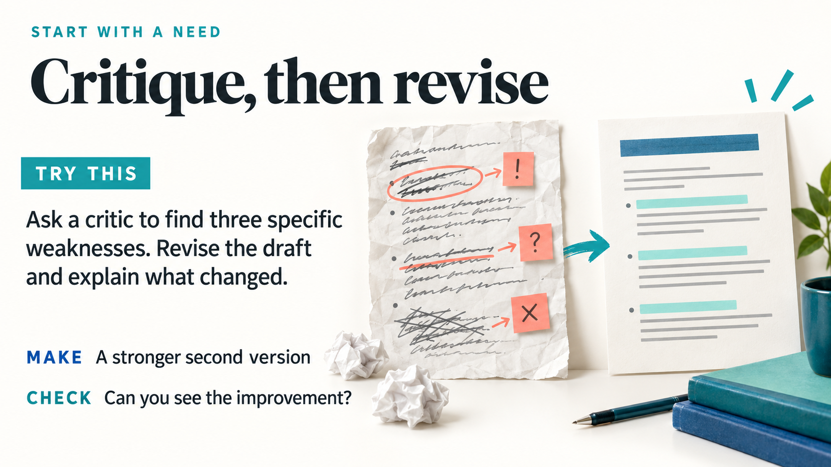
Notes:
27. Critique, then revise
EMBEDDED ACTIVITY · START WITH A NEED
Original activity-library number: 8
TRY THIS: Ask a critic to find three specific weaknesses. Revise the draft and explain what changed.
MAKE: A stronger second version
CHECK: Can you see the improvement?
PLACE IN THE STORY
Show one consequential revision to the campus task: require evidence, a tradeoff, and a limitation. Explain how this changes what students must do.
FULL ACTIVITY TIME
About 5 minutes if completed as a standalone exercise. In the presentation, this may be a short demonstration, audience decision, or take-home invitation.
TOOL
Any agent environment
INPUTS
drafts/activity-v1.md plus the brief and critique; create a first draft if needed.
COPYABLE PROMPT
Read the course brief and drafts/activity-v1.md. Identify the three weaknesses that most affect learning or usability. For each, quote the relevant portion, explain the effect on learners, and propose a precise revision. Then produce drafts/activity-v2.md and drafts/change-log.md after I approve the changes. Preserve supported factual content and list any unresolved uncertainty.
STEPS
1. Compare the draft against three explicit criteria.
2. Choose changes that matter to learning.
3. Inspect version one and version two side by side.
EXPECTED OUTPUT
A stronger second version
REVIEW CHECKS
- Every change addresses a stated issue.
- The outcome is preserved.
- Revision has not introduced new unsupported claims.
FACILITATOR NOTES
Demonstrate a revision with a visible consequence: add an evidence requirement, clarify a misleading chart instruction, or reduce an unnecessary barrier. 'Make it better' gives little basis for judging success; a documented change makes the result reviewable.
VISUAL DESCRIPTION
Two clear before-and-after paper lesson drafts, first cluttered and uneven, second organized and focused, with three coral revision marks migrating into clean teal highlights.
SOURCES
Original teaching synthesis; not an empirical outcome claim.

Slide 27

Notes:
28. Give every revision a reason
NARRATIVE · BUILD WITH A PURPOSE
Visible lead: First draft: choose a proposal.
Visible explanation: Better task: use two observations, explain a tradeoff, and name a limitation.
Suggested narration: 55 seconds
TALK TRACK
Here is a revision with a teaching reason. The first draft says, 'Choose a proposal.' A student can comply by naming a preference. The revised task asks for two observations, a tradeoff, and a limitation, making the reasoning available for discussion. In the full campus task, students also compare the two proposals and justify the recommendation. The underlying topic has stayed the same, but the evidence of learning has changed. This is what a useful change log can capture. Instead of simply recording that the language became clearer, explain what learners can now do and what the instructor can now see.
TEACHING POINT
Judge a revision by the learning evidence it makes possible, not by polish alone.
TRANSITION
We can apply that same clarity of purpose before drafting by exploring several possible learning activities.
VISUAL DESCRIPTION
Two versions of a campus transport task: an empty choice card develops into a rich evidence-backed decision artifact, with two observation tokens, a balancing scale, and a limitation note. Words only in main slide copy.
SOURCES
- Krathwohl (2002), A Revision of Bloom's Taxonomy: An Overview: https://ou.edu/content/dam/assessment/docs/Theory%20Into%20Practice.pdf

Slide 28

Notes:
29. Generate options before choosing
NARRATIVE · DESIGN THE LEARNING
Visible lead: AI can make it easier to explore alternatives.
Visible explanation: The teaching decision is which idea fits the learners, the outcome, and the time you actually have.
Suggested narration: 55 seconds
TALK TRACK
Generating alternatives can loosen our attachment to the first familiar format. The campus decision could become a short written recommendation, a comparison card sort, a discussion with assigned analytical perspectives, or a prediction followed by data exploration. The model can help put those possibilities on the table. The important selection still depends on the class: available time, prior knowledge, participation barriers, and the evidence students will produce. Ten differently worded quizzes are not ten genuinely different teaching ideas. Ask for variation in what students actually do, then select or combine an approach that fits the learning purpose and the classroom you have.
TEACHING POINT
Use generation to widen the option set, then use explicit teaching criteria to choose.
TRANSITION
The next activity produces an idea menu; afterward we examine the thinking those activities ask students to show.
VISUAL DESCRIPTION
A faculty designer considers several different learning activity prototypes then selects a combination that fits a classroom clock and student goal. Colorful paper innovation studio.
SOURCES
Original teaching synthesis; not an empirical outcome claim.

Slide 29
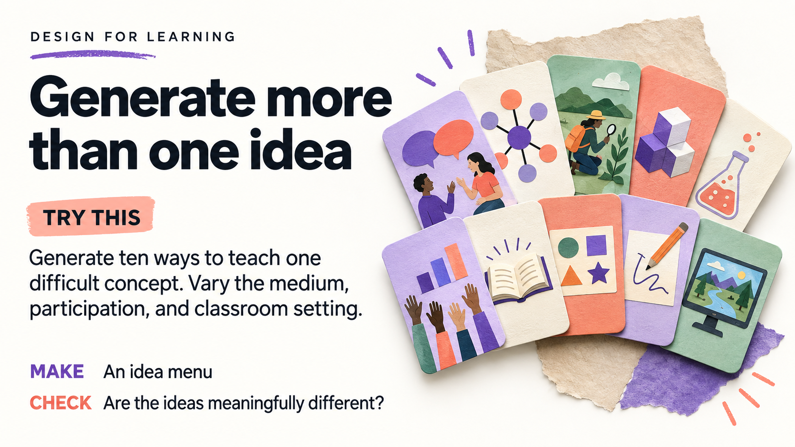
Notes:
30. Generate more than one idea
EMBEDDED ACTIVITY · DESIGN FOR LEARNING
Original activity-library number: 9
TRY THIS: Generate ten ways to teach one difficult concept. Vary the medium, participation, and classroom setting.
MAKE: An idea menu
CHECK: Are the ideas meaningfully different?
PLACE IN THE STORY
Demonstrate divergence, then make an instructor choice. Do not read ten ideas aloud. Compare two contrasting options against the same outcome.
FULL ACTIVITY TIME
About 4 minutes if completed as a standalone exercise. In the presentation, this may be a short demonstration, audience decision, or take-home invitation.
TOOL
Any chat or agent environment
INPUTS
One difficult concept, such as correlation versus causation.
COPYABLE PROMPT
Generate ten substantially different activities for teaching correlation versus causation to first-year students. Include individual, pair, small-group, online, and classroom options. For each provide the student action, evidence of learning, approximate time, needed materials, and one access consideration. Avoid ten variations of a quiz. Use fictional examples and identify them as such in the instructor materials. Save drafts/idea-menu.md.
STEPS
1. Start with one concept and a clear learner level.
2. Ask for variation in student actions and settings.
3. Circle two ideas worth combining.
EXPECTED OUTPUT
An idea menu
REVIEW CHECKS
- Ideas vary in the work students do.
- Each includes observable evidence.
- Materials and time are realistic.
FACILITATOR NOTES
Adaptation examples: analyze a historical source, compare competing interpretations of a poem, diagnose an error in code, or explain a biological mechanism. Keep alternatives meaningfully different. This is deliberate divergence before selecting one approach.
VISUAL DESCRIPTION
A colorful fan of ten idea cards with classroom illustrations: debate, concept map, field observation, model, short experiment, poll, story, sorting, sketch, simulation. No text on cards.
SOURCES
Original teaching synthesis; not an empirical outcome claim.

Slide 30
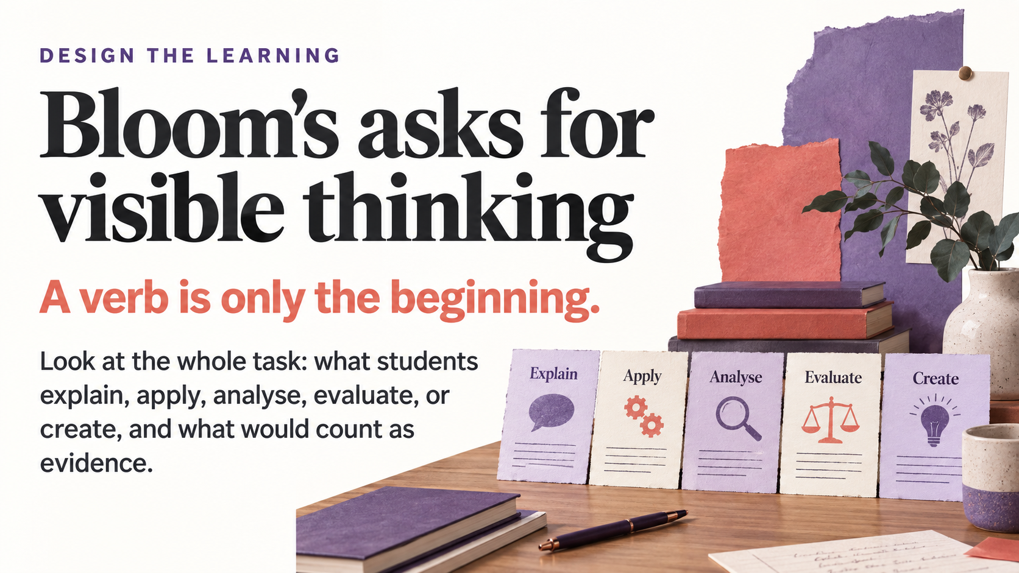
Notes:
31. Bloom's asks for visible thinking
NARRATIVE · DESIGN THE LEARNING
Visible lead: A verb is only the beginning.
Visible explanation: Look at the whole task: what students explain, apply, analyse, evaluate, or create, and what would count as evidence.
Suggested narration: 60 seconds
TALK TRACK
Bloom's revised taxonomy gives us a language for inspecting the work in a task. Its processes are Remember, Understand, Apply, Analyze, Evaluate, and Create, alongside factual, conceptual, procedural, and metacognitive knowledge. The slide shows examples rather than the complete framework. Asking students to 'evaluate' does not establish the demand if they only repeat an answer already supplied. In our case, naming a transport option differs from comparing evidence and defending a decision under uncertainty. Ask what the student must do and what their response would reveal. The aim is alignment with the intended learning, not moving every activity toward Create.
TEACHING POINT
Classify the complete task and its evidence, including the relevant knowledge dimension.
TRANSITION
Use the next activity to compare an explanation, an analysis, and a justified design for the same topic.
VISUAL DESCRIPTION
Equal-height work samples representing explanation, application, analysis, evaluation, and creation laid across a table. Do not make a pyramid or imply every task should aim for Create.
SOURCES
- Krathwohl (2002), A Revision of Bloom's Taxonomy: An Overview: https://ou.edu/content/dam/assessment/docs/Theory%20Into%20Practice.pdf

Slide 31

Notes:
32. Use Bloom's with evidence
EMBEDDED ACTIVITY · DESIGN FOR LEARNING
Original activity-library number: 11
TRY THIS: Turn a vague outcome into observable student work. Try an explanation, an analysis, and a justified design.
MAKE: Three outcome-and-task pairs
CHECK: What will students actually do?
PLACE IN THE STORY
Ask what the complete task reveals, not which verb sounds most advanced. Retain prerequisite knowledge and choose the demand appropriate to the course.
FULL ACTIVITY TIME
About 6 minutes if completed as a standalone exercise. In the presentation, this may be a short demonstration, audience decision, or take-home invitation.
TOOL
Any chat or agent environment
INPUTS
A vague outcome: 'Students understand campus sustainability.'
COPYABLE PROMPT
Replace 'Students understand campus sustainability' with three different outcome-and-task pairs: explain a tradeoff, analyze two proposals using evidence, and design a justified recommendation. Use the revised Bloom framework to name the cognitive process and relevant knowledge dimension for each. State the observable student product and criteria for success. Do not claim the verb alone establishes complexity or that Create is always the best choice. Save drafts/bloom-alignment.md.
STEPS
1. Name the student performance and the evidence it produces.
2. Compare explanation, analysis, and design tasks.
3. Match the level to your actual course purpose.
EXPECTED OUTPUT
Three outcome-and-task pairs
REVIEW CHECKS
- Classification considers the whole task.
- Evidence demonstrates the stated process.
- The task fits learners' prior knowledge.
FACILITATOR NOTES
The revised cognitive processes are Remember, Understand, Apply, Analyze, Evaluate, Create; knowledge dimensions include factual, conceptual, procedural, and metacognitive. Use the framework to inspect alignment, not as a decorative pyramid or a mandate to maximize every task's level. Analyze and evaluate can coexist within a design task.
VISUAL DESCRIPTION
Three equally prominent open sketchbooks showing explanation through annotated diagram, analysis through comparison, and design through prototype. Do not draw a hierarchy or pyramid.
SOURCES
- Krathwohl: A Revision of Bloom's Taxonomy: https://doi.org/10.1207/s15430421tip4104_2

Slide 32

Notes:
36. Research needs an evidence trail
NARRATIVE · RESEARCH WITH EVIDENCE
Visible lead: Generation can help organise an inquiry.
Visible explanation: Claims become usable when you can follow them to real sources, check their meaning, and preserve disagreement.
Suggested narration: 60 seconds
TALK TRACK
An agent can help organize a question, suggest search terms, and compare supplied readings. Retrieval brings external material into the working context; it does not verify every claim made from that material. A real link can accompany an interpretation the source does not support. Build a trail from the teaching claim to the actual passage, then check its meaning, context, and limits. Keep disagreement visible. For genuine research, participants need verified scholarly sources; our fictional campus scenario is useful teaching material but is not a research study. The opportunity is a more inspectable inquiry, with the instructor able to trace how the brief was produced.
TEACHING POINT
Separate retrieval and organization from the act of verifying source support.
TRANSITION
The source-ledger activity makes that trail concrete, one claim and one original passage at a time.
VISUAL DESCRIPTION
A research path connects a question to original readings, quoted passages, a comparison matrix, and a cautious teaching brief. Colored threads remain traceable back to sources.
SOURCES
- Lewis et al. (2020), Retrieval-Augmented Generation for Knowledge-Intensive NLP Tasks: https://arxiv.org/abs/2005.11401
- Gao et al. (2023), Enabling Large Language Models to Generate Text with Citations: https://aclanthology.org/2023.emnlp-main.398/

Slide 33

Notes:
37. Build a source ledger
EMBEDDED ACTIVITY · RESEARCH WITH EVIDENCE
Original activity-library number: 19
TRY THIS: Record each source's title, author, year, link, and relevant passage. Open every source before using it.
MAKE: A verified source ledger
CHECK: Can you trace every claim?
PLACE IN THE STORY
Open one real source and locate support for one claim. This concrete action makes the earlier distinction between fluent text and verified evidence visible.
FULL ACTIVITY TIME
About 10 minutes if completed as a standalone exercise. In the presentation, this may be a short demonstration, audience decision, or take-home invitation.
TOOL
Cursor Agent or Antigravity, plus a browser or library reader
INPUTS
Three participant-selected research sources verified from the actual literature. Place authorized copies or links in sources/. The starter kit does not supply research papers.
COPYABLE PROMPT
Build a source ledger for the real research materials I have provided in sources/. Use only those materials and their verified publication pages. For each source, record source_id, exact title, author or organization, year, DOI or stable URL, source type, the specific claim relevant to my question, page or section, a short supporting passage or faithful paraphrase, limitations, and verification status. Distinguish 'source exists', 'full text read', and 'claim checked'. If you cannot access a full text or confirm metadata, mark it unverified and state what I need to check; never complete missing bibliographic details from guesswork. Save drafts/source-ledger.csv and a concise drafts/source-checks.md. Do not treat APPROVED_READING.md in the starter kit as a published research study.
STEPS
1. Open each publication or source page and confirm that the source exists.
2. Read the relevant passage in context, checking whether it supports the intended claim.
3. Generate the ledger and inspect one row against the original page.
4. Correct metadata or overstatement, and keep inaccessible sources visibly unverified.
EXPECTED OUTPUT
drafts/source-ledger.csv with traceable claims and an honest verification status for every row.
REVIEW CHECKS
- Titles, authors, years, and identifiers match the source.
- The cited passage supports the precise claim and its scope.
- Unverified or inaccessible materials remain labeled as such.
- Paraphrases do not add causality, certainty, or generality absent from the source.
FACILITATOR NOTES
This exercise needs real participant-selected sources. The starter kit's campus scenario is authored teaching material, not research evidence. A source can exist yet fail to support the claim attributed to it. Demonstrate that distinction explicitly. For a short session, thoroughly check one ledger row and assign the remaining rows as follow-up rather than pretending to verify three papers instantly.
VISUAL DESCRIPTION
Source cards in an evidence notebook are tied by colored threads to original bookmarked documents.
SOURCES
- ACRL Framework for Information Literacy for Higher Education: https://www.ala.org/acrl/standards/ilframework

Slide 34

Notes:
39. Find a gap worth testing
EMBEDDED ACTIVITY · RESEARCH WITH EVIDENCE
Original activity-library number: 21
TRY THIS: Ask what your source set does not answer. Turn one possible gap into a question and a follow-up search.
MAKE: A tentative gap statement
CHECK: Is it a gap or a search limit?
PLACE IN THE STORY
Frame the result as a search hypothesis. The question is what this set has not answered and what search would test the absence, not a declaration that no research exists.
FULL ACTIVITY TIME
About 7 minutes if completed as a standalone exercise. In the presentation, this may be a short demonstration, audience decision, or take-home invitation.
TOOL
Cursor Agent or Antigravity, followed by a library search
INPUTS
A verified source ledger, a focused research question, and the actual search record. Use a prepared evidence matrix if available; otherwise derive one from checked sources before proposing a gap.
COPYABLE PROMPT
Read the verified source ledger. If drafts/evidence-matrix.csv is not available, first build a compact claim/method/context/limitation matrix from the sources actually checked. Use the real search log if one is supplied; otherwise state that search coverage has not been documented and do not invent searches. Identify three questions this particular source set does not answer. For each, explain whether the absence may reflect our search terms, database coverage, date or language limits, inaccessible texts, or a plausible gap in the literature. Do not say 'no research exists' based on this small set. Choose one tentative gap and write it as: 'Within the sources reviewed so far, we have not found ...; we will test this by ...'. Give a follow-up search using additional terms, one citation-chaining action, and the evidence that would disconfirm the gap. Save drafts/gap-hypothesis.md. The instructor will decide whether the gap remains defensible after the follow-up search.
STEPS
1. Identify an unanswered question within the reviewed source set.
2. Check whether the search process plausibly produced that absence.
3. Run a targeted follow-up search and inspect references or citing work.
4. Update or abandon the gap statement if relevant evidence is found.
EXPECTED OUTPUT
drafts/gap-hypothesis.md with a qualified statement, follow-up search, and disconfirmation criterion.
REVIEW CHECKS
- The statement is explicitly limited to the reviewed evidence.
- Search limitations are separated from substantive gaps.
- The follow-up could actually discover counterevidence.
- The question remains worth investigating even if the novelty claim changes.
FACILITATOR NOTES
The desired outcome is a testable gap hypothesis, not a confident novelty claim. Finding an earlier study is a successful correction, not a failed exercise. Ask participants what evidence would make them withdraw the proposed gap. Avoid treating the model's inability to retrieve an answer as proof that the literature lacks one.
VISUAL DESCRIPTION
A researcher studies an unfilled space in a wall of research tiles; the gap remains open while surrounding evidence is examined.
SOURCES
- ACRL Framework for Information Literacy for Higher Education — Research as Inquiry: https://www.ala.org/acrl/standards/ilframework

Slide 35
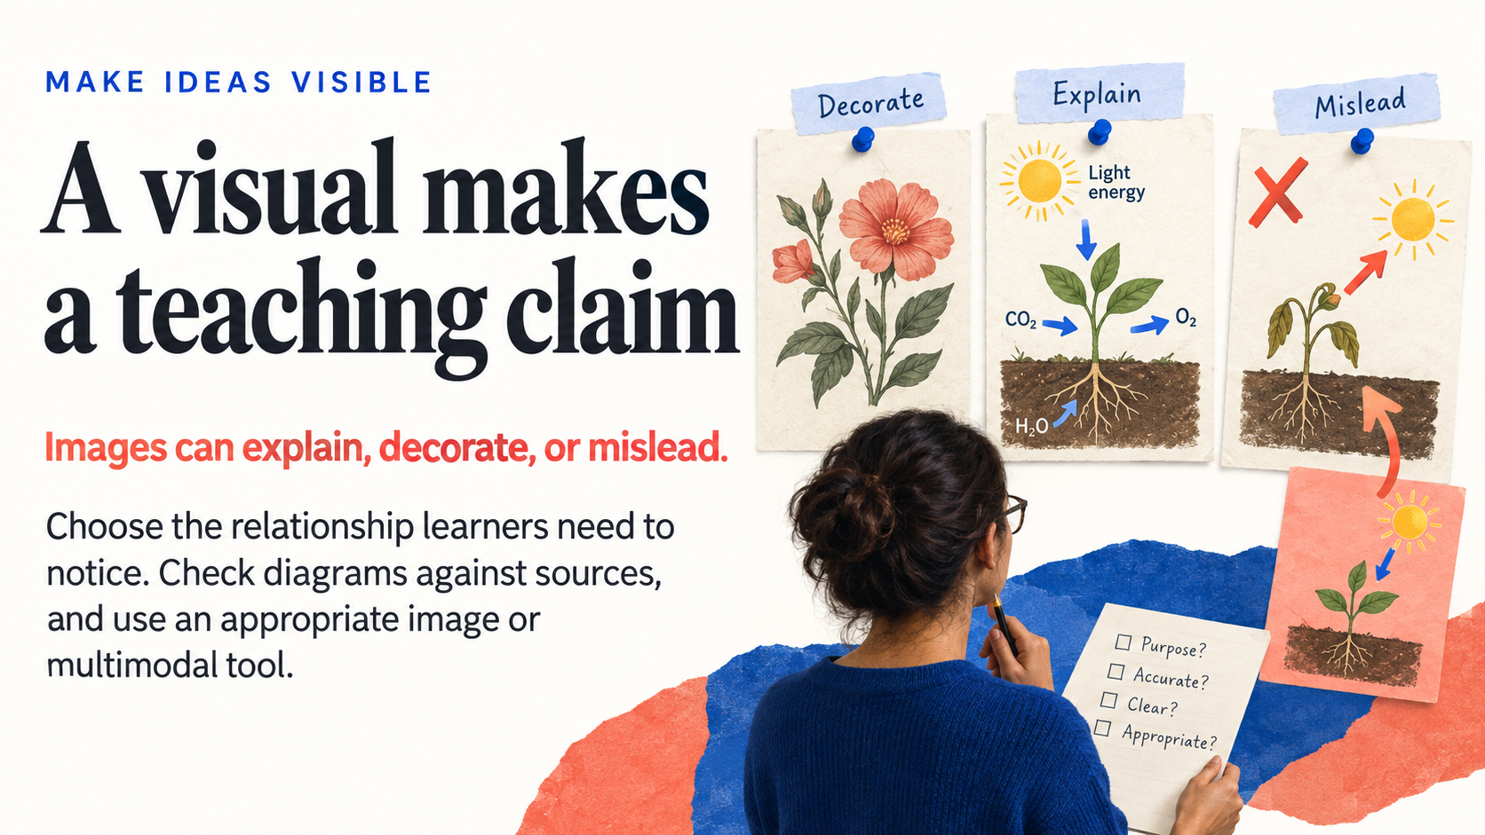
Notes:
40. A visual makes a teaching claim
NARRATIVE · MAKE IDEAS VISIBLE
Visible lead: Images can explain, decorate, or mislead.
Visible explanation: Choose the relationship learners need to notice. Check diagrams against sources, and use an appropriate image or multimodal tool.
Suggested narration: 60 seconds
TALK TRACK
The opening explained text generation, but a product can coordinate more than one kind of model or tool. It may use a multimodal model or call a separate image generator; every image is not produced by the same next-text-token process. The faculty task is to specify what the visual should communicate. A wetland hero image may introduce a module, while a scientific diagram makes more precise claims through its arrows and labels. Both can be attractive, but they require different checks. Start with the relationship learners need to notice, choose an appropriate tool, and plan a text alternative that supports the image's purpose.
TEACHING POINT
Choose visual tools and review criteria according to the image's teaching purpose and claims.
TRANSITION
The image-brief activity turns that purpose into a concrete request before generation begins.
VISUAL DESCRIPTION
Three teaching-image panels show decoration, a clear explanatory relationship, and a misleading arrow being corrected. A faculty reviewer selects a visual based on purpose.
SOURCES
- Gemini Team (2023), Gemini: A Family of Highly Capable Multimodal Models: https://arxiv.org/abs/2312.11805
- Rombach et al. (2022), High-Resolution Image Synthesis with Latent Diffusion Models: https://arxiv.org/abs/2112.10752
- W3C WAI Images Tutorial: https://www.w3.org/WAI/tutorials/images/

Slide 36

Notes:
41. Brief the image before making it
EMBEDDED ACTIVITY · MAKE VISUAL MATERIALS
Original activity-library number: 25
TRY THIS: Specify the learning purpose, subject, composition, style, and what the visual must get right.
MAKE: An image design brief
CHECK: What should learners notice first?
PLACE IN THE STORY
Use the brief to explain the decisions behind an image. The live sequence uses an instructor-prepared first draft before the next visual iteration activity.
FULL ACTIVITY TIME
About 5 minutes if completed as a standalone exercise. In the presentation, this may be a short demonstration, audience decision, or take-home invitation.
TOOL
Cursor, Antigravity, or an approved chat tool to write the brief
INPUTS
A module title, learning purpose, intended image placement, and any instructor-approved visual facts. Example: an introductory ecology module on urban wetlands.
COPYABLE PROMPT
Help me brief an image for a first-year ecology module on urban wetlands. The image will introduce the topic in an LMS module header, not function as a scientific data diagram. Write drafts/image-brief.md specifying: audience and learning purpose; what learners should notice first; required subject matter; composition and title-safe space; a suitable visual style; image aspect ratio 16:9; details that must be verified by the instructor; and what to exclude. The intended scene is a city-edge wetland with water, shoreline vegetation, and a visible relationship to the surrounding built environment. Avoid implying that a specific real site or species assemblage has been documented. Request an illustration, not a documentary photograph. Keep any eventual title as editable text outside the image. Include a provisional text alternative based on the intended purpose, to be revised after seeing the actual output. Do not generate the image yet.
STEPS
1. Name the image's teaching job: orientation, explanation, comparison, or evidence.
2. Specify composition and factual requirements before selecting a visual style.
3. Check whether the image needs to be decorative or informative in its final context.
4. Save the brief and identify the one detail the instructor will inspect first.
EXPECTED OUTPUT
drafts/image-brief.md with a concrete purpose, visual constraints, and review criteria.
REVIEW CHECKS
- The image has an explicit learning purpose.
- The visual does not imply unsupported site-specific facts.
- Title placement and likely crop are considered.
- The text alternative will be finalized from the actual image and context.
FACILITATOR NOTES
This activity makes the request reviewable before generation. A module hero needs different detail from a scientific diagram. Asking for title space is useful, but putting the final title in editable slide or LMS text usually makes revision and access easier. For an actual local wetland, use authorized reference material and verify site-specific claims rather than relying on a generic generation.
VISUAL DESCRIPTION
An image-design brief with purpose and composition cues sits beside three concept thumbnails.
SOURCES
- W3C WAI Images Tutorial: https://www.w3.org/WAI/tutorials/images/

Slide 37

Notes:
42. Iteration needs a stable purpose
NARRATIVE · MAKE IDEAS VISIBLE
Visible lead: Accuracy, clarity, and style are different questions.
Visible explanation: Changing one thing at a time makes it easier to tell whether the visual became more useful for learning.
Suggested narration: 55 seconds
TALK TRACK
Keep the teaching purpose stable while revising the visual. With an urban-wetland illustration, an accuracy pass might address a relationship the instructor has identified as wrong. A clarity pass can reduce competing detail so the important relationship becomes easier to see. A style pass can make the image fit the surrounding module. Combining those requests in one large edit makes it harder to notice unintended changes. Save the versions and compare them against the brief. If the initial audit finds no factual issue, record that rather than inventing a correction. Improvement means the image serves the learning purpose more faithfully, not simply that the latest version looks more polished.
TEACHING POINT
Separate accuracy, clarity, and style so revisions remain attributable and reviewable.
TRANSITION
The next activity demonstrates three distinct review passes using a versioned visual.
VISUAL DESCRIPTION
Three iterations of an urban wetland teaching illustration, each preserves subject while refining factual relationship, focal point, and finishing style. Clear visible improvements without before/after captions.
SOURCES
- W3C WAI Images Tutorial: https://www.w3.org/WAI/tutorials/images/
- W3C WAI Complex Images: https://www.w3.org/WAI/tutorials/images/complex/

Slide 38
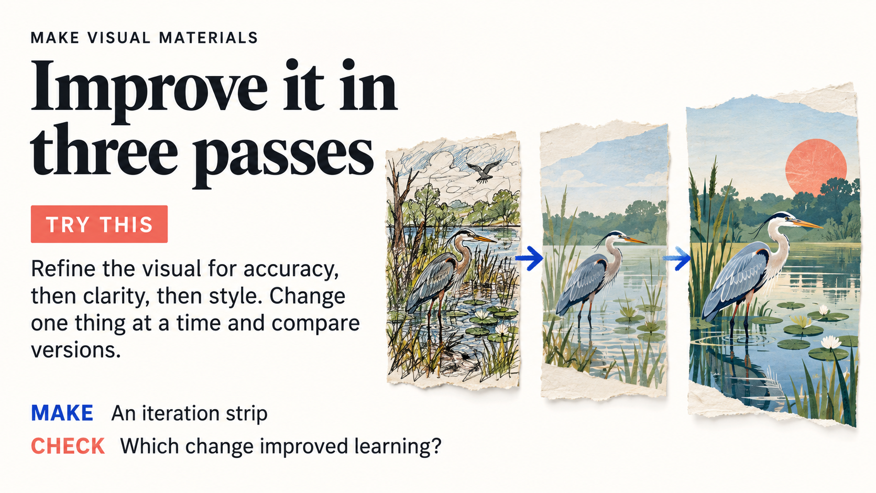
Notes:
43. Improve it in three passes
EMBEDDED ACTIVITY · MAKE VISUAL MATERIALS
Original activity-library number: 28
TRY THIS: Refine the visual for accuracy, then clarity, then style. Change one thing at a time and compare versions.
MAKE: An iteration strip
CHECK: Which change improved learning?
PLACE IN THE STORY
Show a prepared before-and-after pair, then ask what changed for the learner. A factual correction, a clarity change, and a style change answer different questions.
FULL ACTIVITY TIME
About 8 minutes if completed as a standalone exercise. In the presentation, this may be a short demonstration, audience decision, or take-home invitation.
TOOL
Image-generation tool, with Cursor or Antigravity maintaining the brief and change log
INPUTS
An instructor-prepared module image generated from the approved image brief, or another draft image; the brief itself; instructor feedback on one inaccurate detail. Prepare the first image before presenting this activity.
COPYABLE PROMPT
Use the attached wetland module image and its teaching brief. Preserve the subject and intended message: learners should notice the relationship between water, vegetation, and habitat. Keep the original as wetland-v1.png. Make three separate revisions and show each before continuing. Pass 1, accuracy: change only the instructor-identified factual problem; ask for clarification if it is unspecified. Pass 2, clarity: reduce competing background detail so the intended relationship is easier to see, without removing essential information. Pass 3, style: make colour and composition consistent with the course without changing content. Save each version separately and write drafts/visual-change-log.md with the requested change, what actually changed, what stayed stable, and whether another check is needed. Do not label a version accurate solely because it looks realistic.
STEPS
1. Keep the starting image and brief visible.
2. Choose one factual correction, then compare the revised image with the original.
3. Make a clarity pass and a style pass, saving a new file each time.
4. Place the versions side by side; ask which change helps learners answer the intended question.
EXPECTED OUTPUT
Original plus three versioned images and drafts/visual-change-log.md
REVIEW CHECKS
- Was the requested change actually made?
- Did unrelated content drift between versions?
- Is the teaching relationship clearer?
- Are image prompts and accepted versions saved?
FACILITATOR NOTES
The slide shows a simplified progression from busy to focused to polished. Use it to discuss purpose, not as proof that the depicted habitat is scientifically validated. If no factual problem is known, make the first pass an audit and record that no change was requested. Avoid bundling five requests into one edit; it becomes difficult to attribute improvement. Image generation may occur in a separate application from the agent workspace.
VISUAL DESCRIPTION
Three versions of the same wetland illustration progress from a cluttered sketch to a focused, polished composition.
SOURCES
- W3C WAI Images Tutorial: https://www.w3.org/WAI/tutorials/images/
- W3C WAI Complex Images: https://www.w3.org/WAI/tutorials/images/complex/

Slide 39
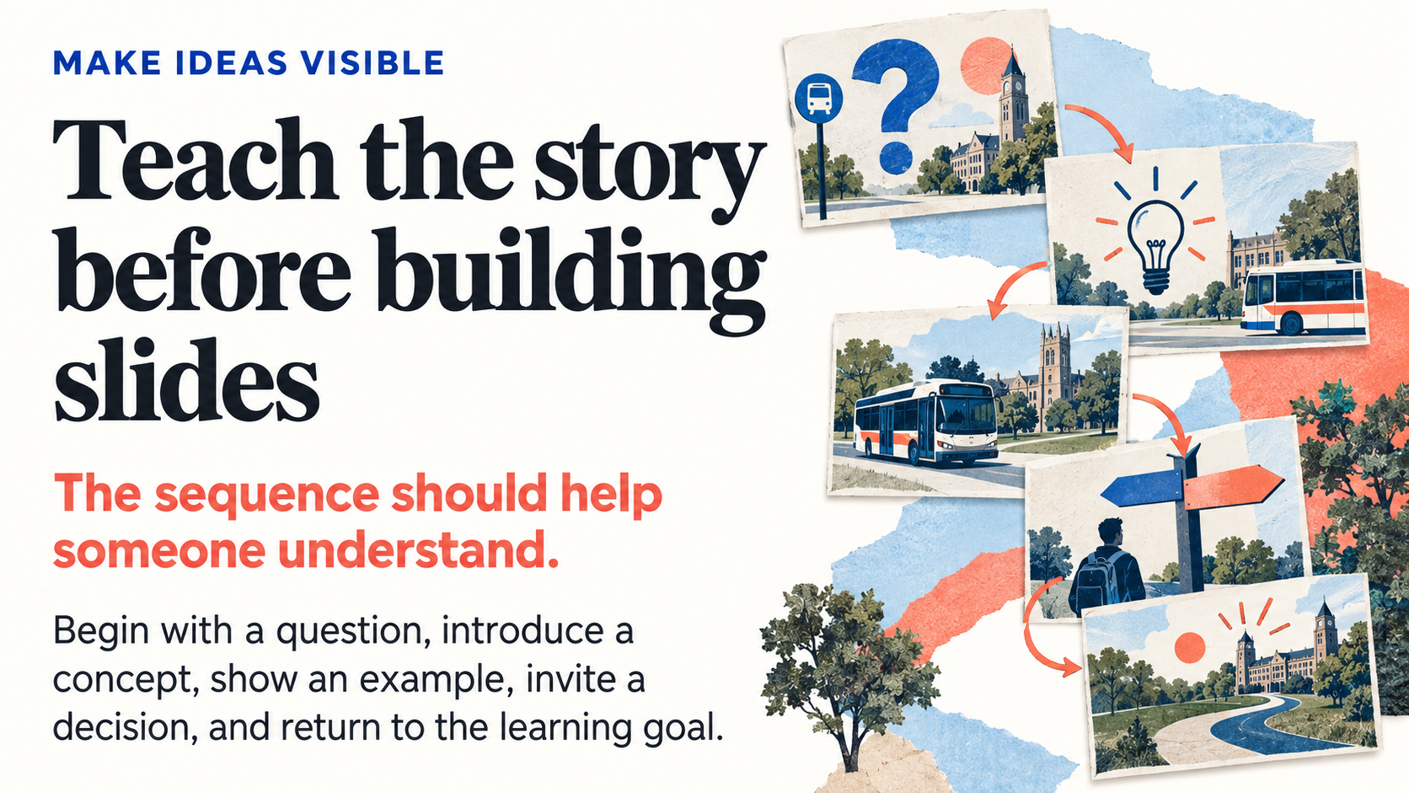
Notes:
44. Teach the story before building slides
NARRATIVE · MAKE IDEAS VISIBLE
Visible lead: The sequence should help someone understand.
Visible explanation: Begin with a question, introduce a concept, show an example, invite a decision, and return to the learning goal.
Suggested narration: 55 seconds
TALK TRACK
A slide deck needs a sequence of understanding. For the campus lesson, begin with the decision learners must make, introduce the evidence and its limits, work through a comparison, then invite students to justify a recommendation. That sequence is different from asking a model to summarize each paragraph of the reading into a slide. A storyboard makes the intended teaching moves visible before we invest in visuals. Give each slide a message, a visual purpose, and something it helps the learner think about. Then inspect the sequence by reading only those messages in order. If the story does not build, adjust the storyboard before building the deck.
TEACHING POINT
Storyboard the progression of understanding before generating finished slides.
TRANSITION
The next activity plans a six-slide micro-lesson around a single question.
VISUAL DESCRIPTION
Five editorial slide thumbnails arranged into a coherent story arc, with a recurring campus transport motif growing from question to evidence-backed decision. No miniature text.
SOURCES
- W3C WAI Making Events Accessible: https://www.w3.org/WAI/teach-advocate/accessible-presentations/
- Krathwohl (2002), A Revision of Bloom's Taxonomy: An Overview: https://ou.edu/content/dam/assessment/docs/Theory%20Into%20Practice.pdf

Slide 40

Notes:
45. Storyboard the lesson slides
EMBEDDED ACTIVITY · MAKE VISUAL MATERIALS
Original activity-library number: 30
TRY THIS: Plan six slides around one question. Give each slide a single message, a visual idea, and a teaching move.
MAKE: A six-slide storyboard
CHECK: Does the sequence tell a story?
PLACE IN THE STORY
Make the sequence do explanatory work. Ask what a learner must understand before the next slide will make sense.
FULL ACTIVITY TIME
About 6 minutes if completed as a standalone exercise. In the presentation, this may be a short demonstration, audience decision, or take-home invitation.
TOOL
Cursor, Antigravity, or another text assistant
INPUTS
One learning outcome, a driving question, and an approved reading or instructor explanation.
COPYABLE PROMPT
Plan a six-slide micro-lesson for first-year students answering: 'Does a strong association mean that one thing caused another?' Learning outcome: students can identify a plausible alternative explanation and state what additional evidence they would seek. Use this instructor-authored fictional example: across twelve weeks, ice-cream sales and pool visits rise together as weather becomes warmer. This example illustrates a possible common cause; it does not establish a measured causal result. Create drafts/correlation-storyboard.md with one row per slide: single message, maximum 25 words of visible copy, visual idea, teaching move, speaker explanation, and source or instructor-example status. Sequence: opening prediction, observed pattern, possible explanation, counterexample, student practice, exit question. Include a short text alternative for each meaningful visual. Do not build the deck until I have reviewed the story.
STEPS
1. Define the question students should be able to answer.
2. Read just the six single-message lines in order; check that the argument develops.
3. Check where students predict, practise, and explain, not only listen.
4. Approve or revise the storyboard before asking for visual production.
EXPECTED OUTPUT
drafts/correlation-storyboard.md with six slide plans and speaker explanations
REVIEW CHECKS
- Is the driving question answered by the sequence?
- Does every slide advance one message?
- Do learners do something with the concept?
- Are examples and sources accurately described?
FACILITATOR NOTES
A storyboard prevents a slide generator from turning a reading into six dense summaries. The numbered miniature cards in the illustration show sequence, not deck pagination. Invite participants to swap in a disciplinary question such as interpreting a poem, assessing an engineering design, or choosing a sampling method. The example is explicitly invented for teaching, so no real data claim is implied.
VISUAL DESCRIPTION
Six miniature slide cards move from a question to a concept, an example, a check, practice, and reflection.
SOURCES
- Krathwohl (2002), A Revision of Bloom's Taxonomy: An Overview: https://ou.edu/content/dam/assessment/docs/Theory%20Into%20Practice.pdf
- W3C WAI Making Events Accessible: https://www.w3.org/WAI/teach-advocate/accessible-presentations/

Slide 41
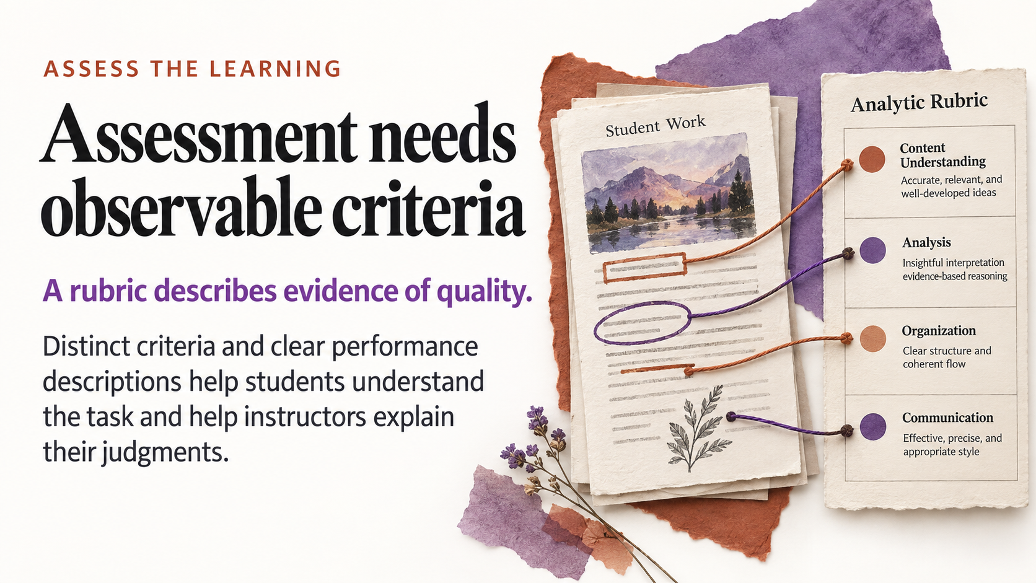
Notes:
46. Assessment needs observable criteria
NARRATIVE · ASSESS THE LEARNING
Visible lead: A rubric describes evidence of quality.
Visible explanation: Distinct criteria and clear performance descriptions help students understand the task and help instructors explain their judgments.
Suggested narration: 55 seconds
TALK TRACK
A rubric turns the learning intention into descriptions of observable quality. For the campus recommendation, a useful descriptor distinguishes evidence that is relevant and accurately interpreted from a number included without explanation. It also makes comparison, tradeoffs, and limitations visible. An agent can draft these distinctions and help us find overlap, such as scoring the same reasoning weakness twice under different labels. The instructor decides whether the descriptions represent the intended standard and whether students can use them to improve. Words such as 'excellent' add little on their own. The next step is to build a rubric, then test its boundaries on contrasting examples.
TEACHING POINT
Write distinct criteria and task-specific performance descriptions that support explanation and improvement.
TRANSITION
Build the rubric in the next activity; the following section will rehearse it with fictional student responses.
VISUAL DESCRIPTION
An evidence artifact placed beside a clear analytic rubric, colored threads connect observable features to distinct criteria. Strong tactile paper composition.
SOURCES
- Krathwohl (2002), A Revision of Bloom's Taxonomy: An Overview: https://ou.edu/content/dam/assessment/docs/Theory%20Into%20Practice.pdf

Slide 42

Notes:
47. Build a rubric from evidence
EMBEDDED ACTIVITY · ASSESS AND FACILITATE
Original activity-library number: 33
TRY THIS: Start with the outcome and student task. Draft distinct criteria and observable descriptions of quality.
MAKE: An analytic rubric
CHECK: Can students tell levels apart?
PLACE IN THE STORY
Display one criterion across performance levels before showing the entire grid. Ask which evidence in a response would distinguish the levels.
FULL ACTIVITY TIME
About 8 minutes if completed as a standalone exercise. In the presentation, this may be a short demonstration, audience decision, or take-home invitation.
TOOL
Cursor or Antigravity
INPUTS
Starter-kit COURSE_BRIEF.md and APPROVED_READING.md for the campus transport proposal exercise; the instructor's assignment requirements.
COPYABLE PROMPT
Read COURSE_BRIEF.md and APPROVED_READING.md. Build a draft analytic rubric for the campus transport proposal: students compare two options, recommend one, use at least two relevant pieces of supplied evidence, and acknowledge a tradeoff and a limitation. Preserve the actual course outcome and task constraints from the brief. Propose four distinct criteria: use of evidence and its limits, comparison of options, reasoning about tradeoffs, and clarity for the intended decision-maker. Draft four performance levels with observable descriptions specific to this task. Avoid labels such as 'excellent' as the only distinction and avoid counting citations as a substitute for judging their relevance. Do not assess grammar as a separate criterion unless it prevents meaning. Produce drafts/recommendation-rubric.md and a CSV version. Explain how each criterion maps to the outcome; leave weighting as an explicit instructor decision. Flag any criterion that goes beyond the supplied assignment.
STEPS
1. Give the agent the actual assignment, outcome, and context.
2. Inspect one criterion across all performance levels for meaningful distinctions.
3. Check that different criteria are not scoring the same quality twice.
4. Save Markdown and CSV versions, then calibrate before using it.
EXPECTED OUTPUT
drafts/recommendation-rubric.md, drafts/recommendation-rubric.csv, and an outcome-to-criterion map
REVIEW CHECKS
- Is every criterion tied to intended learning?
- Are performance levels observable and distinguishable?
- Is the same weakness counted twice?
- Can a student use the descriptors to improve?
- The descriptors explicitly preserve the required evidence, tradeoff, and limitation.
FACILITATOR NOTES
The image is a visual metaphor for an analytic rubric; it is not a rubric ready for grading. The instructor decides criteria and weighting. Generic descriptors can look professional while leaving students unable to distinguish levels. Ask participants to point to evidence in a possible student response that would move it from one descriptor to another.
VISUAL DESCRIPTION
A rubric grid is positioned beside an assignment artifact, with a pencil pointing to evidence in the work.
SOURCES
- Krathwohl (2002), A Revision of Bloom's Taxonomy: An Overview: https://ou.edu/content/dam/assessment/docs/Theory%20Into%20Practice.pdf
- Cursor Quickstart: https://cursor.com/docs/get-started/quickstart

Slide 43

Notes:
50. Cases need a consequential choice
NARRATIVE · ASSESS THE LEARNING
Visible lead: A good case gives students something to reason about.
Visible explanation: Evidence, competing priorities, and a justified decision create room for discussion beyond guessing the instructor's preferred answer.
Suggested narration: 60 seconds
TALK TRACK
Our transport case works because both proposals remain plausible. Evening users may value the shuttle; people who can and want to cycle may value secure parking and repair support. The supplied material does not tell us which pilot would have the greatest effect. That uncertainty creates a reason to ask students for evidence, a tradeoff, and a limitation. A weaker case would quietly build the instructor's preferred answer into every detail. An agent can rapidly produce a scenario, but we need to inspect whether the choice is consequential and whether more than one recommendation can be defended. The quality of the reasoning becomes visible in the justification.
TEACHING POINT
A case should elicit justified choice, not recognition of the instructor's preferred answer.
TRANSITION
Now build a case whose evidence supports a real discussion.
VISUAL DESCRIPTION
A campus decision model with two plausible transport proposals, evidence cards, access considerations, and budget tokens on a seminar table. Both options remain visibly viable.
SOURCES
- Krathwohl (2002), A Revision of Bloom's Taxonomy: An Overview: https://ou.edu/content/dam/assessment/docs/Theory%20Into%20Practice.pdf

Slide 44

Notes:
51. Create a case with a decision
EMBEDDED ACTIVITY · ASSESS AND FACILITATE
Original activity-library number: 37
TRY THIS: Build a fictional case with competing priorities, enough evidence, and a decision students must justify.
MAKE: A discussion case
CHECK: Is there room for reasoned disagreement?
PLACE IN THE STORY
This is an independent fictional case-building example. Transfer the same evidence-and-tradeoff pattern rather than treating its scenario as a factual extension of the starter campus case.
FULL ACTIVITY TIME
About 8 minutes if completed as a standalone exercise. In the presentation, this may be a short demonstration, audience decision, or take-home invitation.
TOOL
Cursor or Antigravity
INPUTS
A decision students should be able to justify. Self-contained fictional campus project values appear in the prompt.
COPYABLE PROMPT
Create a fictional campus sustainability case for a 20-minute first-year seminar. Students must recommend one project within a $60,000 budget. Use these invented options consistently: building lighting upgrade costs $50,000 and is estimated to avoid 18 tonnes CO2e/year; a sheltered cycle hub costs $60,000 with an uncertain estimate of 8–20 tonnes/year and access benefits concentrated among cyclists; a refill-station programme costs $35,000 with an uncertain estimate of 3–7 tonnes/year and convenient locations still to be decided. These are invented teaching assumptions, not real engineering estimates. Include a short scenario, a clear data table, stakeholder perspectives that avoid stereotypes, uncertainty, and three discussion prompts. Require a recommendation, a tradeoff, and one additional piece of evidence students would seek. Save drafts/campus-case.md and a separate facilitator guide. Do not force one predetermined correct answer.
STEPS
1. Choose a decision that requires the target reasoning, not only recalling a fact.
2. Inspect all invented values for internal consistency.
3. Try to justify at least two different recommendations using the stated criteria.
4. Separate the student case from the facilitator's reasoning notes.
EXPECTED OUTPUT
drafts/campus-case.md with a data table and decision task, plus drafts/campus-case-facilitator.md
REVIEW CHECKS
- Is the decision explicit and feasible?
- Are fictional assumptions visibly identified?
- Can more than one option be defended?
- Do stakeholder perspectives avoid caricature?
- Is the required evidence of learning clear?
FACILITATOR NOTES
The figures are deliberately synthetic. Their purpose is to make competing criteria visible, not to teach real emissions calculations. A useful case provides enough evidence to reason while preserving authentic uncertainty. Invite participants to replace the fictional values with checked local or disciplinary material before formal use. Assess the quality of justification rather than agreement with the instructor.
VISUAL DESCRIPTION
Learners examine a campus map with budget, access, and environmental-priority cards around a central funding decision.
SOURCES
- Krathwohl (2002), A Revision of Bloom's Taxonomy: An Overview: https://ou.edu/content/dam/assessment/docs/Theory%20Into%20Practice.pdf
- CAST UDL Guidelines 3.0: https://udlguidelines.cast.org/

Slide 45

Notes:
52. A resource can respond
NARRATIVE · BUILD AN EXPERIENCE
Visible lead: Code can turn teaching ideas into small experiences.
Visible explanation: A local page can reveal feedback, change a display, or guide a decision. Start with a resource simple enough to inspect.
Suggested narration: 60 seconds
TALK TRACK
The same course brief can become more than a handout. In our local module, selecting a travel mode changes the rows and descriptive averages. A self-check responds to an answer, and a reflection space gives learners somewhere to formulate a recommendation. Those are small behaviours, but they create a different teaching experience. An agent environment can help create the file, inspect it, and revise it using tool feedback. We should still begin with an object we can understand. One page with two checks is easier to review than a sprawling course platform. The useful question is what the learner can now notice, attempt, or explain.
TEACHING POINT
A small working resource makes teaching ideas testable.
TRANSITION
The next activity turns a bounded brief into an actual page.
VISUAL DESCRIPTION
A static teaching handout transitions into an interactive browser-like learning page showing feedback, a changing data display, and a decision path. Conceptual UI with no product logo.
SOURCES
- Cursor Quickstart: https://cursor.com/docs/get-started/quickstart
- Google Antigravity Artifacts: https://www.antigravity.google/docs/artifacts/
- Anthropic, Building effective agents: https://www.anthropic.com/engineering/building-effective-agents

Slide 46
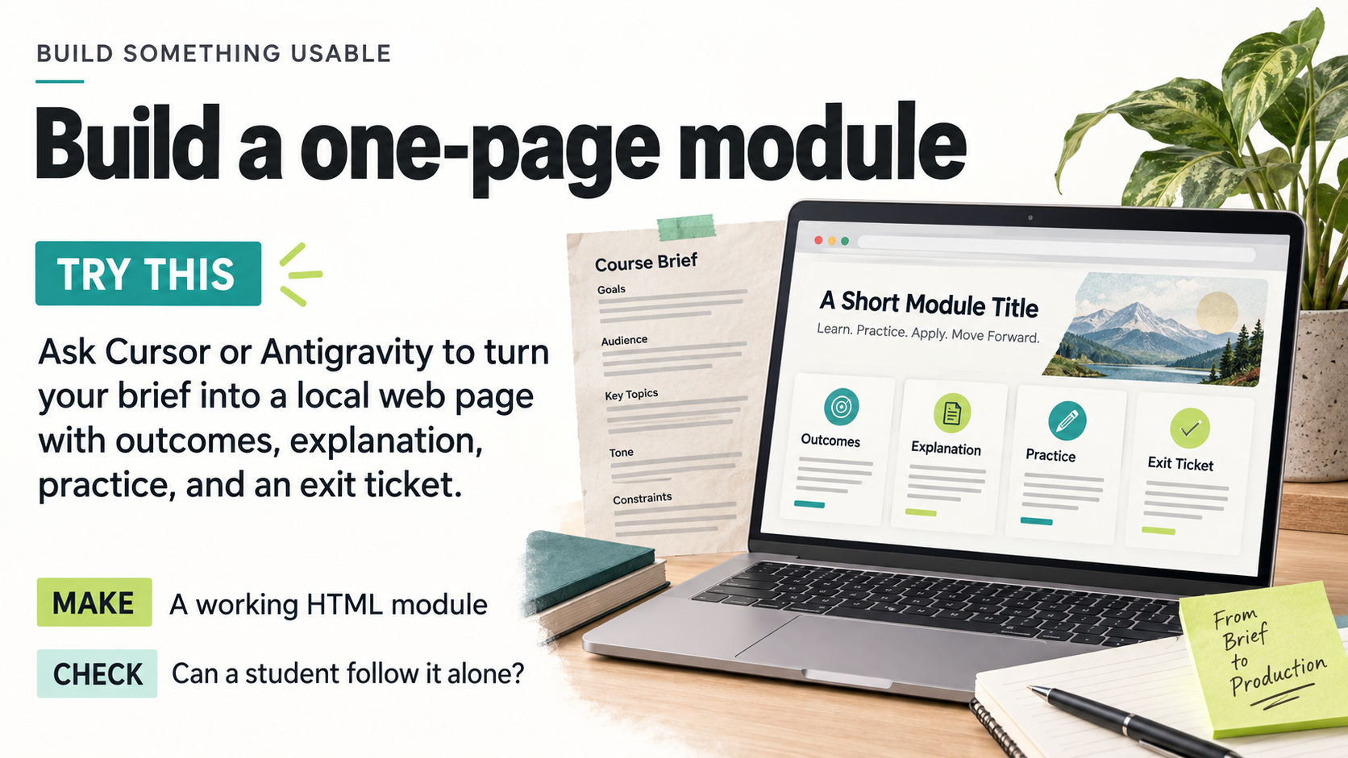
Notes:
53. Build a one-page module
EMBEDDED ACTIVITY · BUILD SOMETHING USABLE
Original activity-library number: 41
TRY THIS: Ask Cursor or Antigravity to turn your brief into a local web page with outcomes, explanation, practice, and an exit ticket.
MAKE: A working HTML module
CHECK: Can a student follow it alone?
PLACE IN THE STORY
Open the supplied example module as a fallback. Show a real student path rather than only the agent's completion message. Request one bounded change if time permits.
FULL ACTIVITY TIME
About 12 minutes if completed as a standalone exercise. In the presentation, this may be a short demonstration, audience decision, or take-home invitation.
TOOL
Cursor or Antigravity with the workshop folder open; any modern browser
INPUTS
COURSE_BRIEF.md and APPROVED_READING.md; a new folder for this build.
COPYABLE PROMPT
Read COURSE_BRIEF.md and APPROVED_READING.md. Plan a 10-minute introductory learning module about evaluating a campus sustainability decision. Show the learning outcome, student journey, proposed sections, and acceptance checks before building. After I approve the plan, create module.html with an outcome, a concise explanation grounded only in the supplied reading, one worked comparison, a practice decision with explanatory feedback, and a two-sentence exit-ticket prompt. Label the authored teaching reading accurately; do not invent external citations. Include a source note and a printable view. Use one self-contained HTML file with inline CSS and JavaScript. It must open by double-clicking the file, with no build step, external library, network request, API key, account, or learner-data collection. Use semantic headings, explicit form labels, keyboard controls, visible focus, readable contrast, and feedback that does not depend on colour alone. Keep student answers only in page memory until reset or reload. Do not promise LMS gradebook integration.
STEPS
1. Use Cursor Plan Mode, or Antigravity Planning with Request Review, for the proposed module.
2. Check whether the practice and exit ticket really demonstrate the chosen outcome.
3. Approve the plan and ask the agent to build module.html.
4. Double-click the file in a browser and complete the activity without instructor explanation.
5. Request one focused revision, such as clearer comparison criteria or better practice feedback.
EXPECTED OUTPUT
A local HTML module with explanation, meaningful practice, feedback, exit ticket, sources and print view.
REVIEW CHECKS
- The file opens offline without a terminal or account.
- Every activity is traceable to the brief and supplied reading.
- Practice feedback explains why a choice is defensible or incomplete.
- Keyboard users can reach every control and see focus.
- A new learner can complete the module and exit ticket unaided.
FACILITATOR NOTES
This is a small usable page, not a full LMS course. Ask participants to narrate what the learner is expected to do at each step. A polished page can still omit the practice needed for the outcome. If the browser tools are unavailable in the assistant, complete the browser test manually and describe the issue back to the agent. The prompt deliberately avoids a software toolchain so faculty can keep and reopen the artifact.
VISUAL DESCRIPTION
A course brief sits beside a laptop containing a one-page learning module, with sections for outcomes, explanation, practice and an exit ticket.
SOURCES
- Cursor Quickstart: https://cursor.com/docs/get-started/quickstart
- Cursor Plan Mode: https://cursor.com/help/ai-features/plan-mode
- Google Antigravity Getting Started: https://www.antigravity.google/docs/getting-started
- Google Antigravity Artifact Review: https://www.antigravity.google/docs/artifact-review
- Web Content Accessibility Guidelines 2.2: https://www.w3.org/TR/WCAG22/

Slide 47

Notes:
54. Interaction should reveal thinking
NARRATIVE · BUILD AN EXPERIENCE
Visible lead: A click is not evidence of learning by itself.
Visible explanation: Ask learners to predict, choose, explain, or revise. The interaction should make a useful relationship visible.
Suggested narration: 60 seconds
TALK TRACK
A working button tells us that the interface responded. It does not tell us what the learner understood. In the transport example, filtering to cycling might help a student notice a mean travel time. The learning appears when the student explains what that mean describes and why it does not predict everyone's experience after changing modes. That suggests a purposeful sequence: make a prediction, inspect the result, explain the difference, then revise a claim. The agent can build the controls. We supply the intellectual move those controls should support. Before adding another interaction, ask what evidence of thinking it would make available.
TEACHING POINT
Interaction needs to reveal reasoning that matters to the outcome.
TRANSITION
Try a small interaction with a clear prediction or explanation at its centre.
VISUAL DESCRIPTION
A learner predicts an outcome, manipulates a simple interactive model, then compares the result and revises an explanation. Four tangible connected cards, no equations or hidden correctness claim.
SOURCES
- Krathwohl (2002), A Revision of Bloom's Taxonomy: An Overview: https://ou.edu/content/dam/assessment/docs/Theory%20Into%20Practice.pdf
- Anthropic, Building effective agents: https://www.anthropic.com/engineering/building-effective-agents

Slide 48

Notes:
55. Build a branching scenario
EMBEDDED ACTIVITY · BUILD SOMETHING USABLE
Original activity-library number: 43
TRY THIS: Turn a case into three decision points with consequences and feedback. Map every path before generating the page.
MAKE: A branching learning activity
CHECK: Can every path reach a useful debrief?
PLACE IN THE STORY
Use a branch map before building. Explain why the debrief and path coverage matter more than the novelty of clicking through a story.
FULL ACTIVITY TIME
About 14 minutes if completed as a standalone exercise. In the presentation, this may be a short demonstration, audience decision, or take-home invitation.
TOOL
Cursor or Antigravity with the workshop folder open; any modern browser
INPUTS
COURSE_BRIEF.md and APPROVED_READING.md; campus sustainability decision as the shared case.
COPYABLE PROMPT
Read the course brief and approved teaching reading. Design a campus sustainability decision scenario with exactly three sequential decision points and two options at each point. Keep all eight choice sequences reachable. Branch-specific consequences may differ, but every sequence must reach a debrief about evidence, stakeholder priorities and trade-offs. First save scenario-map.md with each decision, the two options, immediate feedback, possible accumulated consequences and all eight terminal sequences. Use fictional context and no unsupported claims about a real institution. After I approve the map, build scenario.html. Include a visible record of the learner's choices, a debrief, and restart. Ask the learner to defend one trade-off; do not reduce a defensible policy choice to a single simplistic right answer. Use one self-contained HTML file with inline CSS and JavaScript. It must open by double-clicking the file, with no build step, external library, network request, API key, account, or learner-data collection. Use semantic headings, explicit form labels, keyboard controls, visible focus, readable contrast, and feedback that does not depend on colour alone. Also save a path-test.md table recording the eight paths and whether each reaches its debrief.
STEPS
1. Review the map before generating the interactive page.
2. Check that alternatives are plausible and their consequences are consistent with the reading.
3. Build the page, then deliberately choose the least expected path.
4. Test all eight sequences and compare them with the map.
5. Revise one shallow feedback message to explain a trade-off and invite justification.
EXPECTED OUTPUT
A mapped and tested branching scenario, with feedback on choices and a useful debrief on every path.
REVIEW CHECKS
- All eight choice sequences terminate without a dead end.
- Consequences do not contradict earlier choices.
- The final debrief refers to the learner's actual decisions.
- Restart clears the old state.
- Feedback uses the supplied evidence and makes room for justified alternatives.
FACILITATOR NOTES
Three decisions with two choices produce eight full sequences; branching does not require eight wholly separate stories. Reconverging paths can keep the build manageable while preserving choice-specific consequences. The learning target is reasoned decision-making, not guessing which option the instructor secretly prefers.
VISUAL DESCRIPTION
A campus case appears as a tactile branching board with decision junctions leading to different evidence and feedback cards.
SOURCES
- Cursor Plan Mode: https://cursor.com/help/ai-features/plan-mode
- Google Antigravity Artifacts: https://www.antigravity.google/docs/artifacts/
- Web Content Accessibility Guidelines 2.2: https://www.w3.org/TR/WCAG22/

Slide 49

Notes:
56. Data can invite better questions
NARRATIVE · BUILD AN EXPERIENCE
Visible lead: A chart is the start of interpretation.
Visible explanation: Keep the source rows, units, filters, and limitations visible. Ask what the display supports and what it cannot establish.
Suggested narration: 60 seconds
TALK TRACK
Keep the data close to the display. Our module has sixteen synthetic records, with four examples of each mode. Cycling averages twenty minutes and car travel averages twenty-four and a half minutes in those records. The arithmetic is straightforward; the interpretation needs care. Distances and circumstances differ, and this is not a representative survey or a test of either proposal. That makes the dataset useful for teaching a limit as well as a pattern. Whether we use a chart or a table, learners should be able to recover the source rows, see the units, and ask what further evidence would change their recommendation.
TEACHING POINT
Traceable displays support interpretation; descriptive means do not establish intervention effects.
TRANSITION
The next activity lets learners inspect the rows and their limits.
VISUAL DESCRIPTION
A synthetic campus transport table linked visibly to a filterable chart and a student interpretation notebook. Traceable rows and units represented cleanly; no fabricated numerical conclusions.
SOURCES
- Krathwohl (2002), A Revision of Bloom's Taxonomy: An Overview: https://ou.edu/content/dam/assessment/docs/Theory%20Into%20Practice.pdf

Slide 50

Notes:
57. Let students explore data
EMBEDDED ACTIVITY · BUILD SOMETHING USABLE
Original activity-library number: 44
TRY THIS: Use a small synthetic dataset to build a filterable chart and interpretation questions. Check the chart against the source rows.
MAKE: A classroom data explorer
CHECK: What could the display mislead about?
PLACE IN THE STORY
Use the supplied synthetic rows. Compare one displayed number with the underlying records before discussing the interpretation. The included demo already provides a table/filter starting point.
FULL ACTIVITY TIME
About 12 minutes if completed as a standalone exercise. In the presentation, this may be a short demonstration, audience decision, or take-home invitation.
TOOL
Cursor or Antigravity with the workshop folder open; any modern browser
INPUTS
sample-data.csv, the provided synthetic campus transit dataset, and COURSE_BRIEF.md.
COPYABLE PROMPT
Read sample-data.csv first and report its actual columns, units, row count and missing values. Propose one learning question this synthetic campus transit dataset can support. Do not invent columns or treat the observations as causal evidence. After I approve, build transit-explorer.html: embed the exact CSV rows in the file; offer one meaningful category filter; show a clearly labelled bar chart, count of included rows, the displayed summary calculation, and the matching source rows in an accessible table. Use a zero baseline for bars. Distinguish totals, averages and percentages and state the denominator. Include three interpretation questions and a revealable teaching note explaining one limitation. Handle an empty result with a readable message. Use one self-contained HTML file with inline CSS and JavaScript. It must open by double-clicking the file, with no build step, external library, network request, API key, account, or learner-data collection. Use semantic headings, explicit form labels, keyboard controls, visible focus, readable contrast, and feedback that does not depend on colour alone. If the file lacks the fields needed for the requested chart, explain the mismatch and propose a supported chart instead. Save data-check.md comparing three displayed results with calculations from the underlying rows.
STEPS
1. Inspect the actual data schema before specifying a chart.
2. Choose a single classroom question and meaningful filter.
3. Build the offline page and inspect a filtered view.
4. Recalculate three displayed values from source rows.
5. Ask learners to identify a conclusion the data cannot support.
EXPECTED OUTPUT
A filterable local chart with source rows, explicit calculations and interpretation questions.
REVIEW CHECKS
- Every plotted value matches the embedded source data.
- Labels identify units, aggregation and denominator.
- The source table updates with the filter.
- The chart makes clear that the dataset is synthetic.
- An empty filter state is usable.
- The discussion avoids causal conclusions from descriptive observations.
FACILITATOR NOTES
Use the supplied synthetic data to practise interpretation, not to make claims about the institution. Filtered totals can change because the number of included observations changes. Ask what the denominator means before discussing a percentage. A source table makes the chart inspectable and provides a useful access alternative.
VISUAL DESCRIPTION
A campus transit themed laptop dashboard contains a filter, a bar chart and the corresponding data table. The slide asks viewers to check the display against the source rows.
SOURCES
- Cursor Quickstart: https://cursor.com/docs/get-started/quickstart
- Google Antigravity Artifacts: https://www.antigravity.google/docs/artifacts/
- W3C WAI Complex Images: https://www.w3.org/WAI/tutorials/images/complex/
- Web Content Accessibility Guidelines 2.2: https://www.w3.org/TR/WCAG22/

Slide 51

Notes:
59. The educator sets the standard
NARRATIVE · WHAT REMAINS OURS
Visible lead: A system can draft, compare, and critique.
Visible explanation: Faculty decide what counts as evidence, what the task should assess, and whether the result belongs in their course.
Suggested narration: 65 seconds
TALK TRACK
Return to the campus transport module we started with. The goal was a defensible recommendation, supported by two pieces of evidence, a tradeoff, and a limitation. Consider a hypothetical weak first draft: a polished page asks which proposal is correct and awards a green tick for choosing cycling. Its interface could work perfectly while assessing the wrong thing. The consequential revision is to separate the reasoning checks from the proposal choice. Our actual module does this: it challenges an unsupported population claim and an unsupported causal claim, then leaves either proposal open to a justified recommendation. The educator sets that standard. The system helps realise it, but the meaning of a successful student response comes from our intended learning.
TEACHING POINT
The consequential design decision is what counts as learning, not how polished the resource appears.
TRANSITION
Once the standard is explicit, we can see different ways a good-looking draft might fall short.
VISUAL DESCRIPTION
An educator reviews a finished resource against real student work, approved sources, and course purpose, rather than a generic approval stamp. Quiet authoritative academic scene.
SOURCES
- Krathwohl (2002), A Revision of Bloom's Taxonomy: An Overview: https://ou.edu/content/dam/assessment/docs/Theory%20Into%20Practice.pdf
- Anthropic, Building effective agents: https://www.anthropic.com/engineering/building-effective-agents

Slide 52

Notes:
60. Four ways the work can go wrong
NARRATIVE · WHAT REMAINS OURS
Visible lead: Accuracy. Alignment. Access. Information handling.
Visible explanation: A wrong claim, the wrong task, an unusable resource, or an inappropriate input can undermine an otherwise polished result.
Suggested narration: 65 seconds
TALK TRACK
That imaginary green tick helps us distinguish problems that can otherwise blur together. If the page invents a measured emissions reduction, the problem is accuracy. If it rewards our preferred transport proposal, the problem is alignment. If a learner cannot reach the answer controls with a keyboard, the problem is access. If we supplied identifiable student work to a tool without a suitable basis, the problem began with information handling. These are different failure routes, even when the final page looks attractive. For this demonstration, we chose an original fictional scenario and synthetic records. That let us practise the workflow with a bounded source set. In a real course, the instructor's context determines which inputs and uses are appropriate.
TEACHING POINT
Different failures require different review questions and different remedies.
TRANSITION
The next step is to choose evidence that can actually reveal each kind of problem.
VISUAL DESCRIPTION
Four compact review scenes: unsupported reference, misaligned assessment, blocked keyboard path, and source selection boundary. Respectful restrained visual, no panic symbols or fake student records.
SOURCES
- Web Content Accessibility Guidelines 2.2: https://www.w3.org/TR/WCAG22/
- Krathwohl (2002), A Revision of Bloom's Taxonomy: An Overview: https://ou.edu/content/dam/assessment/docs/Theory%20Into%20Practice.pdf
- Anthropic, Building effective agents: https://www.anthropic.com/engineering/building-effective-agents

Slide 53

Notes:
61. Verification changes with the artifact
NARRATIVE · WHAT REMAINS OURS
Visible lead: Use a check that can reveal the actual problem.
Visible explanation: Open the citation. Recalculate the table. Try the wrong answer. Walk every branch.
Suggested narration: 65 seconds
TALK TRACK
Ask three separate questions about the transport resource. Does it function? Change every filter, submit incomplete and incorrect answers, and reset the page. Is its content supported? Compare all sixteen rows with the supplied CSV, recalculate the means, and check each claim against the approved scenario. Does it elicit the intended learning? Read a learner's recommendation and look for relevant evidence, a tradeoff, and an acknowledged limit. None of those questions can stand in for the others. A passing browser test does not establish a sound inference; a correct mean does not show that the learner can reason with it. The agent can assist with these checks, but we need observations that address the actual question, including student work.
TEACHING POINT
Function, evidence, and learning are distinct questions; each needs appropriate observations.
TRANSITION
Access is part of making that learning experience available in the first place.
VISUAL DESCRIPTION
Four real review actions on an academic workbench: open source, hand calculation, incorrect quiz response with explanation, branching map traced to endpoints. High clarity and purposeful layout.
SOURCES
- Anthropic, Building effective agents: https://www.anthropic.com/engineering/building-effective-agents
- Gao et al. (2023), Enabling Large Language Models to Generate Text with Citations: https://aclanthology.org/2023.emnlp-main.398/
- Krathwohl (2002), A Revision of Bloom's Taxonomy: An Overview: https://ou.edu/content/dam/assessment/docs/Theory%20Into%20Practice.pdf

Slide 54

Notes:
63. Keep trust visible
NARRATIVE · WHAT REMAINS OURS
Visible lead: Make the basis of the material inspectable.
Visible explanation: Explain how it was developed, which sources support it, and what students are expected to do with it.
Suggested narration: 65 seconds
TALK TRACK
Students should be able to understand what kind of material they are using. Our module says that the campus and data are invented, links the original local inputs, and explains that neither proposal is universally correct. Those details are part of the teaching, because they shape the claims a student can responsibly make. A concise development note can also describe where an agent assisted and what the instructor reviewed. For research-based materials, the source needs to support the actual claim, not merely appear in a bibliography. For a case, the assumptions need to be visible. This transparency gives learners and colleagues a way to question the resource and improve it, rather than asking them to trust a polished surface.
TEACHING POINT
Visible assumptions, sources, and expectations support informed use and review.
TRANSITION
That shifts our attention from producing more drafts to making better decisions about them.
VISUAL DESCRIPTION
A transparent teaching resource folder presents a concise development note, visible sources, clear student expectations, and revision history. No excessive policy checklist or invented regulations.
SOURCES
- Gao et al. (2023), Enabling Large Language Models to Generate Text with Citations: https://aclanthology.org/2023.emnlp-main.398/
- Google Antigravity Artifacts: https://www.antigravity.google/docs/artifacts/

Slide 55

Notes:
64. Spend time where judgment matters
NARRATIVE · WHAT REMAINS OURS
Visible lead: Easier drafting can change where the work goes.
Visible explanation: More attention can go to specifying the task, reviewing evidence, trying the student experience, and improving the result.
Suggested narration: 65 seconds
TALK TRACK
We began with the possibility of generating material quickly. The more interesting possibility is changing where we spend our attention. In the transport example, producing another paragraph may matter less than noticing that a question rewards a causal inference the dataset cannot support. A useful revision might take only one sentence: explain that the group mean describes these records and does not predict the effect of switching modes. The system can help make that revision across the page, answer key, and teaching notes. The instructor recognises why it matters. This is not a promise of a particular number of hours saved. It is a choice about where easier drafting allows us to invest: the task, the evidence, the learner's experience, and the quality of the next version.
TEACHING POINT
The value of easier drafting depends on where faculty direct the resulting attention.
TRANSITION
Preserve those decisions so the next version begins with understanding.
VISUAL DESCRIPTION
A faculty workbench shifts attention from a pile of first drafts toward thoughtful review of an actual learner artifact and a resource revision. No quantitative time-saving graph.
SOURCES
- Anthropic, Building effective agents: https://www.anthropic.com/engineering/building-effective-agents
- Cursor Quickstart: https://cursor.com/docs/get-started/quickstart

Slide 56

Notes:
65. Reuse the process, not just the answer
NARRATIVE · WHAT REMAINS OURS
Visible lead: A good workflow becomes a teaching asset.
Visible explanation: Keep the brief, sources, prompts, criteria, and change notes so the next term starts from something understandable.
Suggested narration: 65 seconds
TALK TRACK
Suppose you return to this activity next term. A finished HTML file alone may leave you wondering why the case used sixteen records, why either recommendation was allowed, or why the feedback rejected a causal conclusion. The brief, approved reading, source data, and review notes answer those questions. They also let another instructor adapt the material without reconstructing the reasoning from scratch. The reusable asset is the production context as well as the output. You can replace the scenario, update an evidence source, or adjust the learner level while preserving the intended outcome and checks. Ask the agent to read that context explicitly. Keeping it in a folder does not by itself establish that the system used the relevant parts correctly.
TEACHING POINT
Retain the rationale and review context needed to maintain and adapt the artifact.
TRANSITION
The saved context supports a production pattern that travels across tools.
VISUAL DESCRIPTION
A reusable course production kit unfolds across two teaching terms, with a stable brief and evidence folder feeding a thoughtfully revised resource. Seasonal dates not needed.
SOURCES
- Cursor Quickstart: https://cursor.com/docs/get-started/quickstart
- Cursor Plan Mode: https://cursor.com/help/ai-features/plan-mode

Slide 57
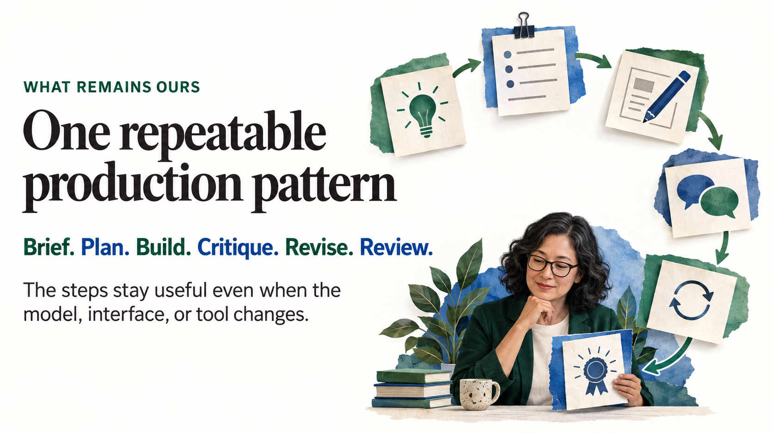
Notes:
66. One repeatable production pattern
NARRATIVE · WHAT REMAINS OURS
Visible lead: Brief. Plan. Build. Critique. Revise. Review.
Visible explanation: The steps stay useful even when the model, interface, or tool changes.
Suggested narration: 65 seconds
TALK TRACK
Our transport example followed a pattern that remains useful beyond today's interfaces. The brief defined the learning and source boundaries. The plan made the proposed page inspectable before production. The build created something we could open. Critique identified a concrete issue, such as an unsupported inference or confusing feedback. Revision addressed that issue, and review checked the changed resource against the original purpose. Those steps can be light or substantial. A single well-framed response may be enough for a short explanation. A fixed workflow may suit a recurring format. An agent loop becomes useful when building requires actions, observations, and adjustments. We do not need maximum automation for every task; we need a process proportionate to the work and a clear point of acceptance.
TEACHING POINT
Choose a response, workflow, or agent loop according to the task; retain inspectable review.
TRANSITION
That leaves several realistic places to begin next week.
VISUAL DESCRIPTION
A elegant six-part paper workflow forms a coherent arc leading from teaching need to reviewed resource; visual only, no repeated extra text. Faculty reviewer visible at final step.
SOURCES
- Anthropic, Building effective agents: https://www.anthropic.com/engineering/building-effective-agents
- Cursor Plan Mode: https://cursor.com/help/ai-features/plan-mode
- Google Antigravity Artifact Review: https://www.antigravity.google/docs/artifact-review

Slide 58

Notes:
67. Three possibilities for next week
NARRATIVE · WHAT REMAINS OURS
Visible lead: A reading guide. A calibrated rubric. A branching case.
Visible explanation: Choose one resource where a better question, clearer evidence, or a useful interaction would improve the learning experience.
Suggested narration: 65 seconds
TALK TRACK
Picture three colleagues leaving this session with different projects. One wants a reading guide that helps students distinguish a claim from its supporting evidence. Another has an assessment where the rubric sounds clear until two reviewers disagree. A third wants a branching professional case in which students explain a decision before seeing its consequences. Each could use the same production pattern, but the useful result and the review would differ. The reading guide needs accurate source relationships. The rubric needs rehearsal with contrasting work. The case needs plausible choices and feedback that supports reflection. The transport module is one example of this wider possibility. Choose a resource where you already recognise a teaching problem, so that the improvement has a purpose you can explain.
TEACHING POINT
Begin with a known teaching need and choose an artifact whose improvement can be evaluated.
TRANSITION
Then define what would make that improvement worth using with students.
VISUAL DESCRIPTION
Three finished but adaptable resources on a bright faculty desk: annotated reading guide, calibrated rubric, and branching case, each with one visible improvement marker.
SOURCES
- Krathwohl (2002), A Revision of Bloom's Taxonomy: An Overview: https://ou.edu/content/dam/assessment/docs/Theory%20Into%20Practice.pdf
- Anthropic, Building effective agents: https://www.anthropic.com/engineering/building-effective-agents

Slide 59

Notes:
68. What would make this worth using?
NARRATIVE · WHAT REMAINS OURS
Visible lead: Judge the learning experience, not just the polish.
Visible explanation: Look for clearer student work, fewer avoidable barriers, sound evidence, and a resource you can maintain.
Suggested narration: 65 seconds
TALK TRACK
How would we know the transport module was worth keeping? A professional appearance is useful, but it is only one part of the answer. We would want to see whether student recommendations use evidence more carefully, acknowledge a meaningful tradeoff, and avoid claiming an effect the data cannot establish. We would also notice barriers: confusing wording, inaccessible controls, or instructions that assume knowledge the learners do not yet have. Those observations guide the next revision. They are not a claim that this demonstration has already produced learning gains. We have tested technical behaviour; the classroom question still needs learner evidence. A resource worth using should also be understandable enough that its instructor can correct, update, and explain it after the initial excitement has passed.
TEACHING POINT
Judge value using learner evidence, access, sound content, and maintainability; avoid inferring learning gains from technical tests.
TRANSITION
Keep the first project small enough to make those judgments possible.
VISUAL DESCRIPTION
A polished resource is evaluated alongside actual-looking fictional student reasoning samples, a removed obstacle, verified evidence, and maintainable files. No generic star rating.
SOURCES
- Krathwohl (2002), A Revision of Bloom's Taxonomy: An Overview: https://ou.edu/content/dam/assessment/docs/Theory%20Into%20Practice.pdf
- Web Content Accessibility Guidelines 2.2: https://www.w3.org/TR/WCAG22/
- Anthropic, Building effective agents: https://www.anthropic.com/engineering/building-effective-agents

Slide 60

Notes:
70. Better materials begin with better judgment
NARRATIVE · WHAT REMAINS OURS
Visible lead: AI can help turn an idea into a usable resource.
Visible explanation: The educator keeps the purpose, the evidence, and the final teaching decision.
Suggested narration: 65 seconds
TALK TRACK
At the beginning, we had a course brief and a teaching intention. We can now point to a resource, inspect its evidence, try its behaviour, and ask what a learner would do with it. That is the promise of moving from prompt to production: an idea can become something concrete enough to improve. The tools may draft, build, compare, and help test. The educator keeps responsibility for the purpose of the activity, the meaning of the evidence, and the decision to use it. You do not need to leave with a new course platform or a perfected prompt. Leave with one worthwhile teaching problem, one bounded build, and a standard you can explain. Better materials begin there, with the judgment that gives production a direction.
TEACHING POINT
End with a concrete, bounded build governed by an explicit teaching standard.
TRANSITION
Pause, invite final reflection, then move to questions.
VISUAL DESCRIPTION
A closing hero composition revisits the opening faculty desk, now with a completed reviewed resource and a learner's thoughtful work, warm inviting light and broad white space.
SOURCES
- Anthropic, Building effective agents: https://www.anthropic.com/engineering/building-effective-agents
- Krathwohl (2002), A Revision of Bloom's Taxonomy: An Overview: https://ou.edu/content/dam/assessment/docs/Theory%20Into%20Practice.pdf

Slide 61


